Slide 1

Hello everyone!
I hope you are all well and in good health!
Here is presented what you can do in English …
I miss you all!
Sending you my love and best wishes!
Maria Christou

Slide 2
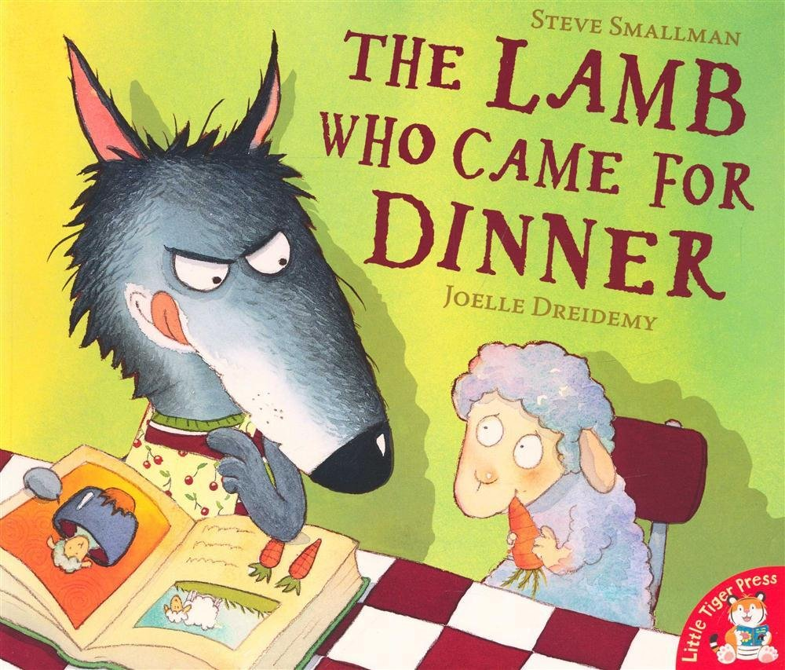
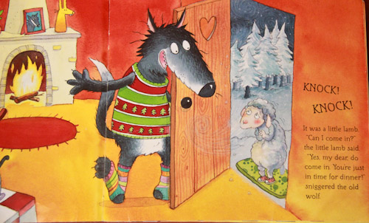
“The lamb who came for dinner” by Steve Smallman
Year 5

Slide 3

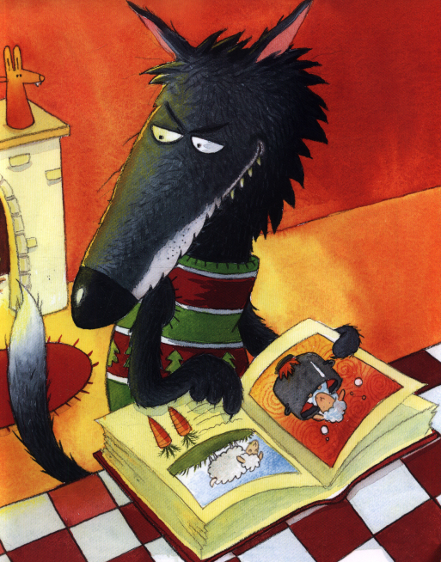
Click on the link below to listen to the story.
‘
https://www.youtube.com/watch?v=-LL6M-JobYY

Slide 4

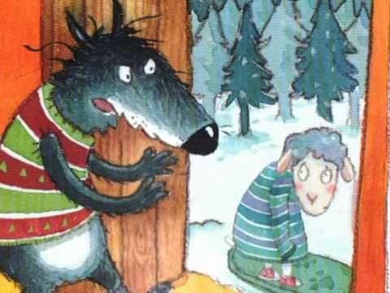
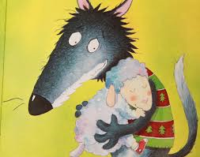
Let’s learn this:
‘Goodness gracious me’ is a mainly British idiomatic expression, usually used to express surprise. ‘goodness’ is also used in other expressions such ‘goodness gracious’ (oh, my God! – again expression of surprise or disbelief) ‘oh, my goodness’ (oh my God! – expression of surprise or disbelief) and ‘for goodness sake’ (expression of frustration and annoyance).

Slide 5
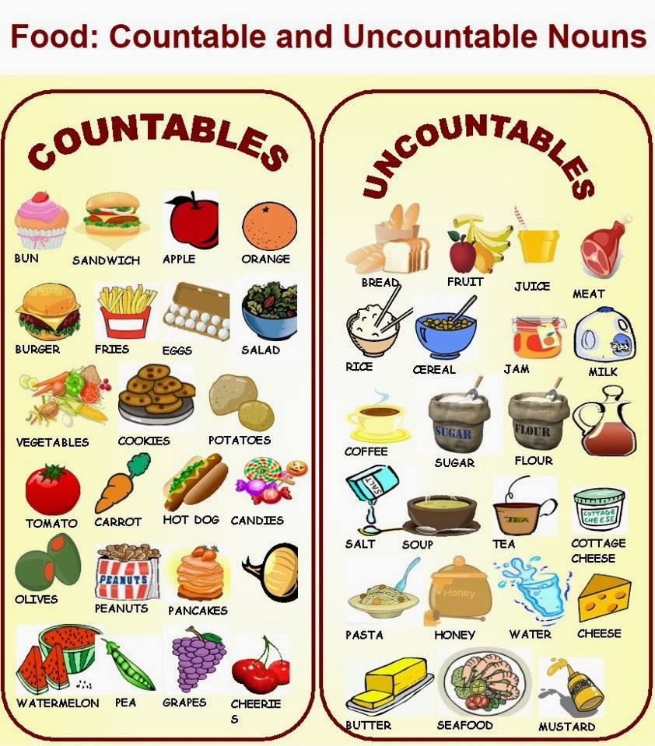
Let’s remember this:

Slide 6
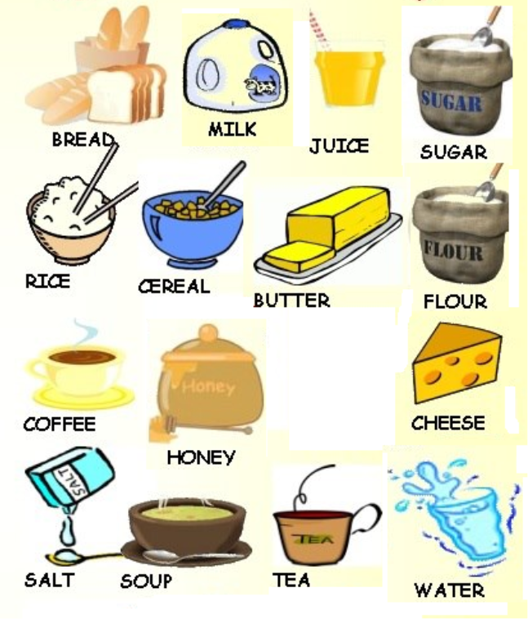
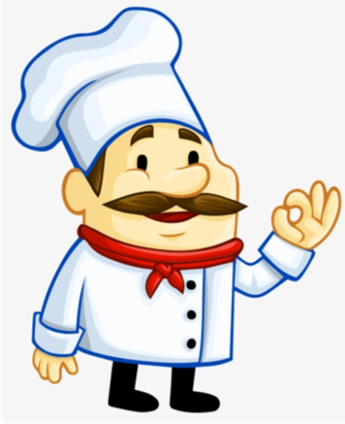
These are called uncountable nouns because we can’t count them. So we use some.

Slide 7
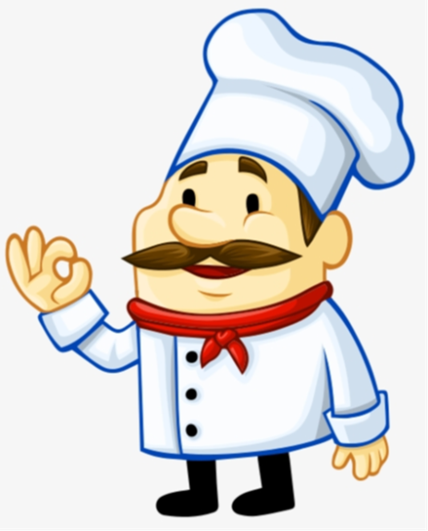
I can say
There is a banana in the fridge.
There is an apple in the fridge.
There is an egg in the fridge.
I can’t say
There is a milk in the fridge.
There is a bread in the fridge
BUT

Slide 8

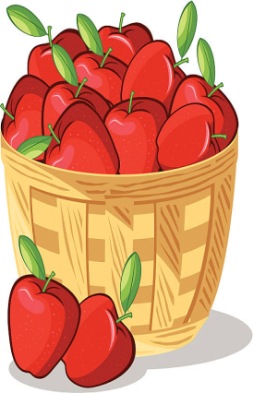
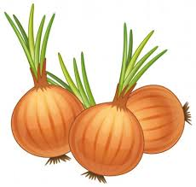
“There is some..”
There is some milk in the fridge.
There is some bread in the fridge.
“There are some..”
There are some apples in the fridge.
There are some onions in the fridge.

Slide 9
BE CAREFUL!
There isn’t an apple.
There isn’t any sugar.
There aren’t any pears.

Slide 10
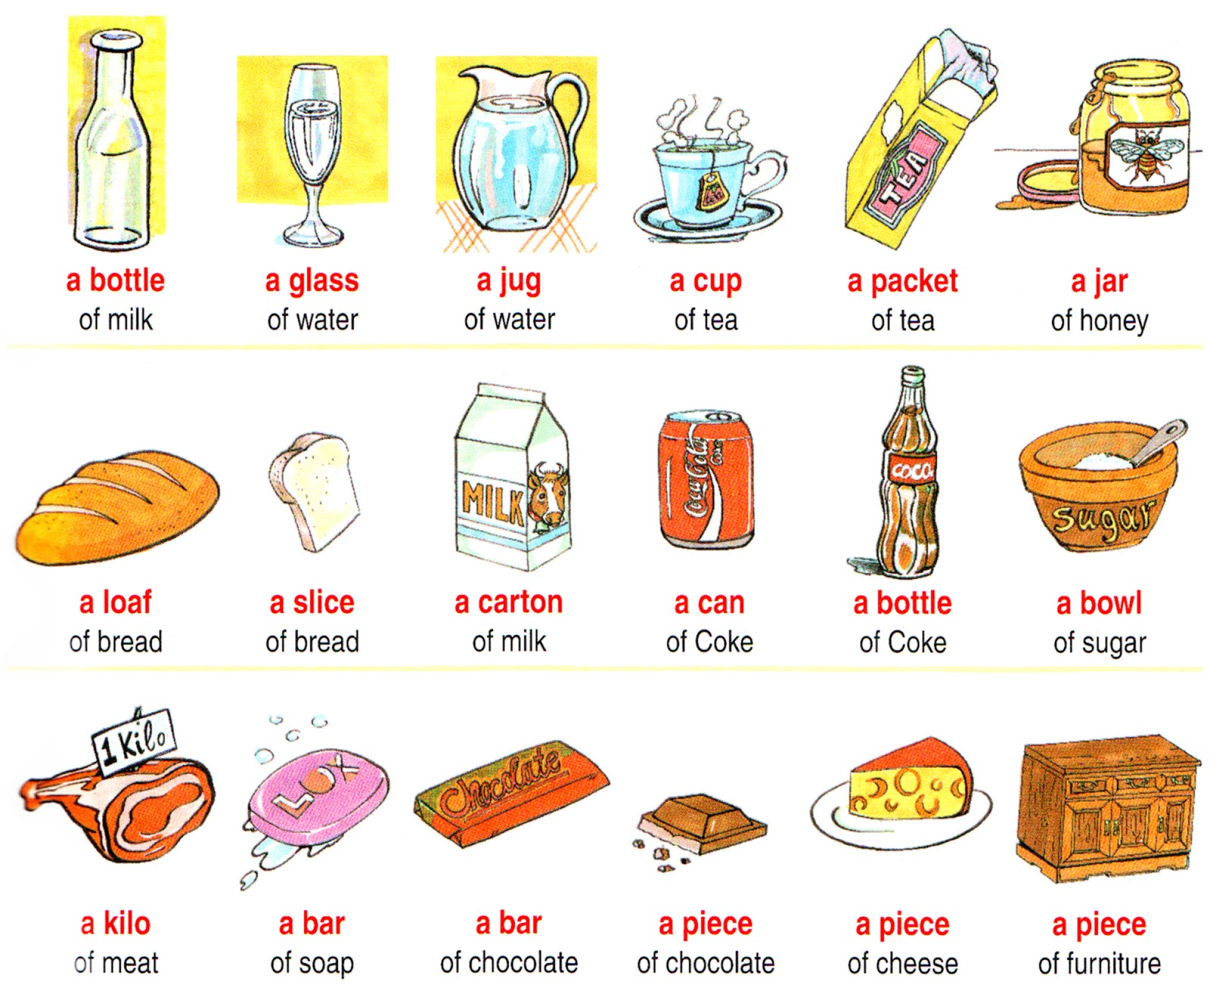

We can also use these phrases!

Slide 11
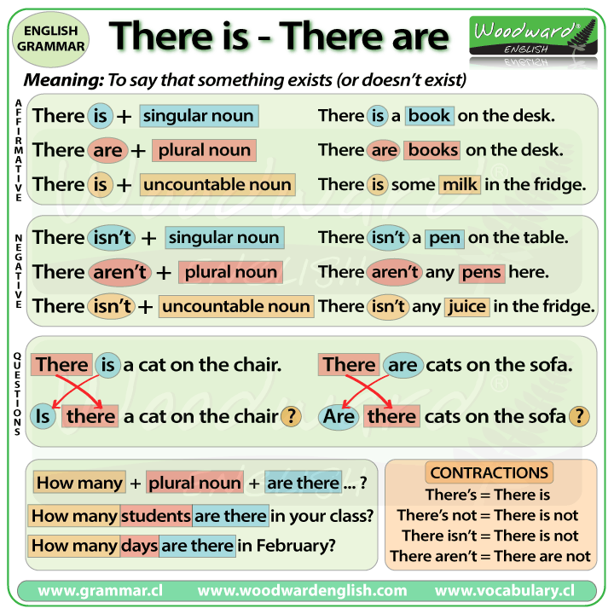
this...

Slide 12
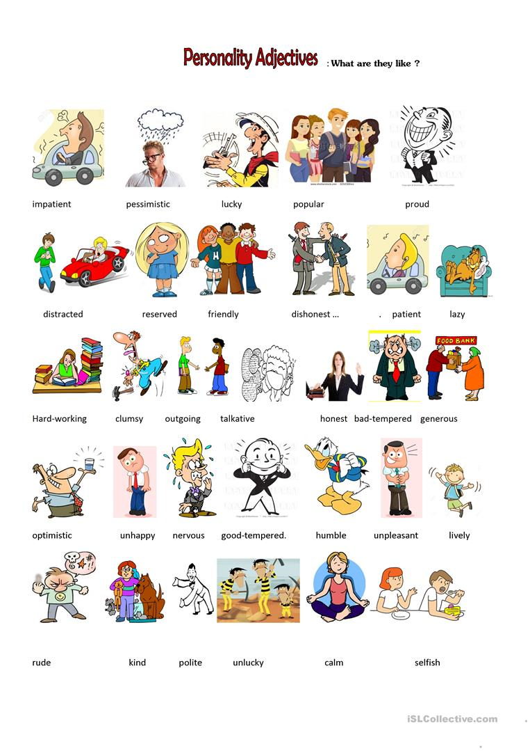
this...

Slide 13
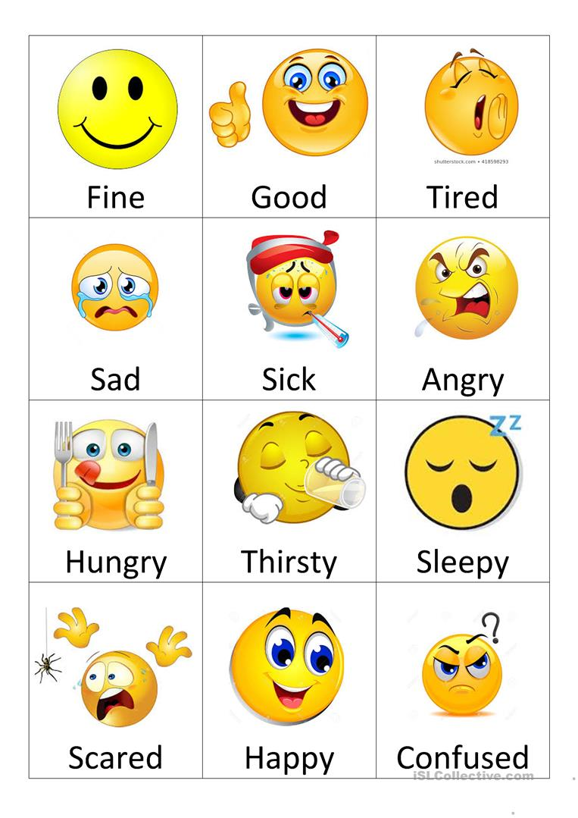
and this...

Slide 14
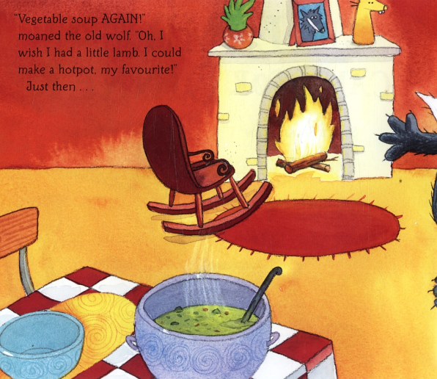
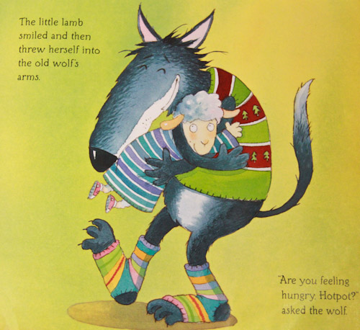
Answer the questions in your notebook «ΤΟ ΣΧΟΛΕΙΟ ΜΑΣ ΕΙΝΑΙ ΕΔΩ»:
What was wolf like in the beginning? How did he feel?
How did the lamb feel in the beginning?
How did the wolf change by the end of the story? Why did he change?
What nice things did the lamb do?

Slide 15
Let’s practice:
Each slide shows a sentence based on the picture shown on the slide. The sentences used have the structures: ‘There is/are …. ‘ There is/are some …’ ‘There isn’t any…’ ‘There aren’t any…’. For each sentence decide if it is correct or not.
If the sentence is correct, write a √ in your notebook «ΤΟ ΣΧΟΛΕΙΟ ΜΑΣ ΕΙΝΑΙ ΕΔΩ».
If you think it’s wrong, write an X. If the sentence is indeed wrong, you can correct it in your notebook «ΤΟ ΣΧΟΛΕΙΟ ΜΑΣ ΕΙΝΑΙ ΕΔΩ»

Slide 16
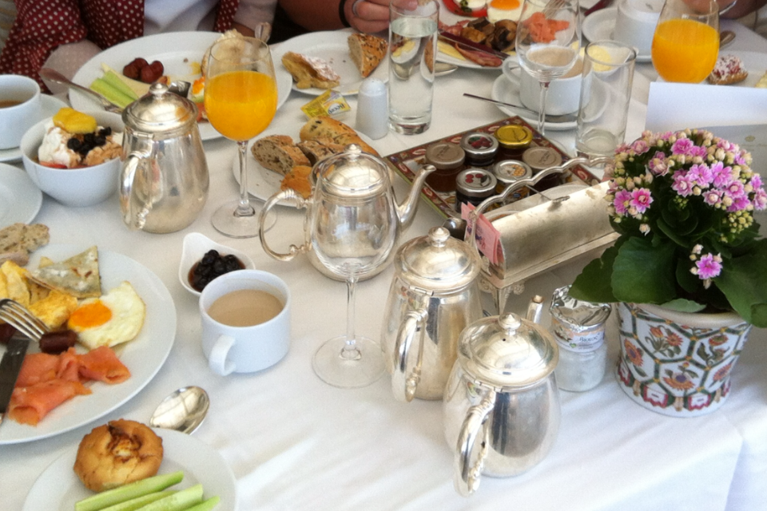
There is some bread on the table.

Slide 17
There isn’t any juice on the table.

Slide 18
There are some peppers on the table.

Slide 19
There aren’t any eggs on the table.

Slide 20
There is some coffee on the table.

Slide 21
There are some mushrooms on the table.

Slide 22
There aren’t any cucumbers on the table.

Slide 23
There are some olives on the table.

Slide 24
There isn’t any ham on the table.

Slide 25
There is some water on the table.

Slide 26
There isn’t any salt on the table.

Slide 27
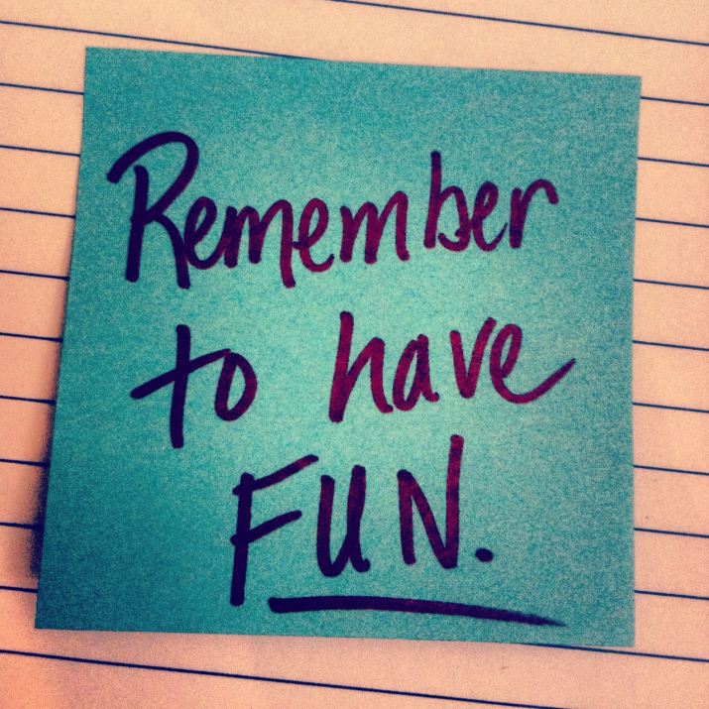
Click on the link below to play the two games! Don't forget when you finish to click on ‘finish’ for feedback!
https://learnenglishkids.britishcouncil.org/grammar-practice/nouns-countable-and-uncountable?page=3

Slide 28
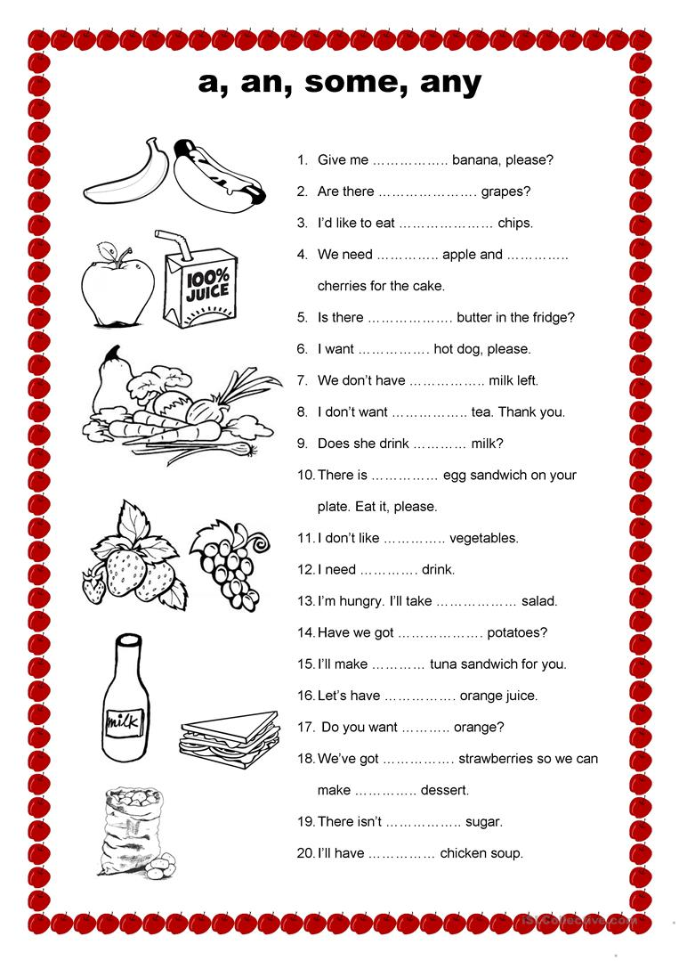
Write the answers in your notebook «ΤΟ ΣΧΟΛΕΙΟ ΜΑΣ ΕΙΝΑΙ ΕΔΩ»

Slide 29
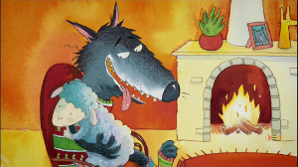
Click on the link below to listen to the story one more time!
https://www.youtube.com/watch?v=oM8lBY5zPrY

Slide 30


