Slide 1
Hello everyone!
I hope you are all well and in good health!
Here is presented what you can do in English now…
I miss you all!
Sending you my love and best wishes!
Maria Christou

Slide 2

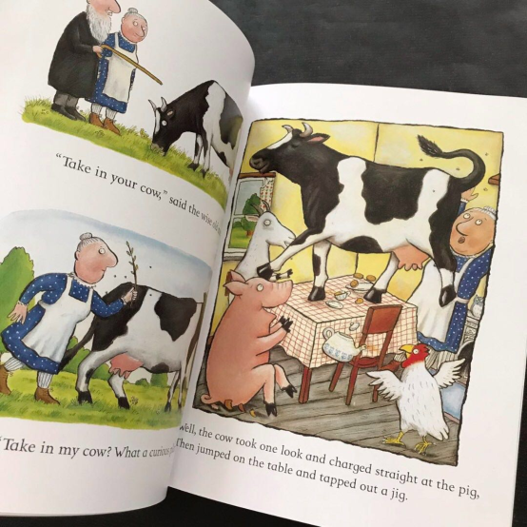
A squash and a squeeze
By Julia Donaldson
Year 5

Slide 3
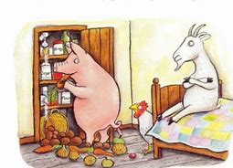
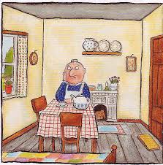
Click on the link below to listen to the story.
https://www.youtube.com/watch?v=PkdX73Onf04

Slide 4
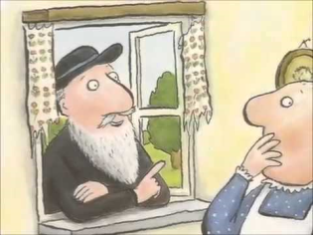
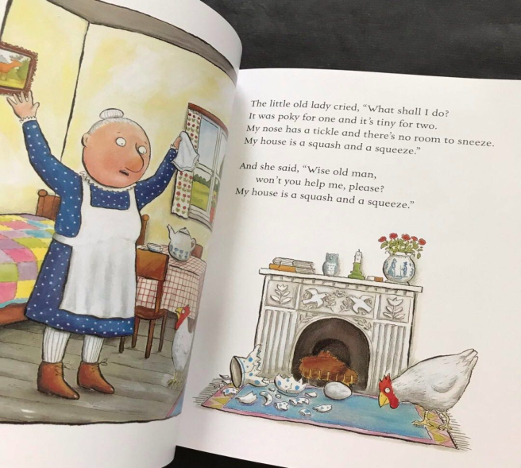
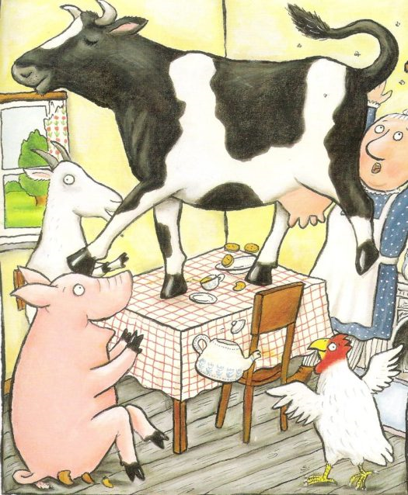
Answer the questions in your note book «ΤΟ ΣΧΟΛΕΙΟ ΜΑΣ ΕΙΝΑΙ ΕΔΩ»:
1.Is the wise man clever? Why is he clever?
2.Is it important to have a big house? Why?
3.Write the animals in the right order that the old lady put them in the house.

Slide 5
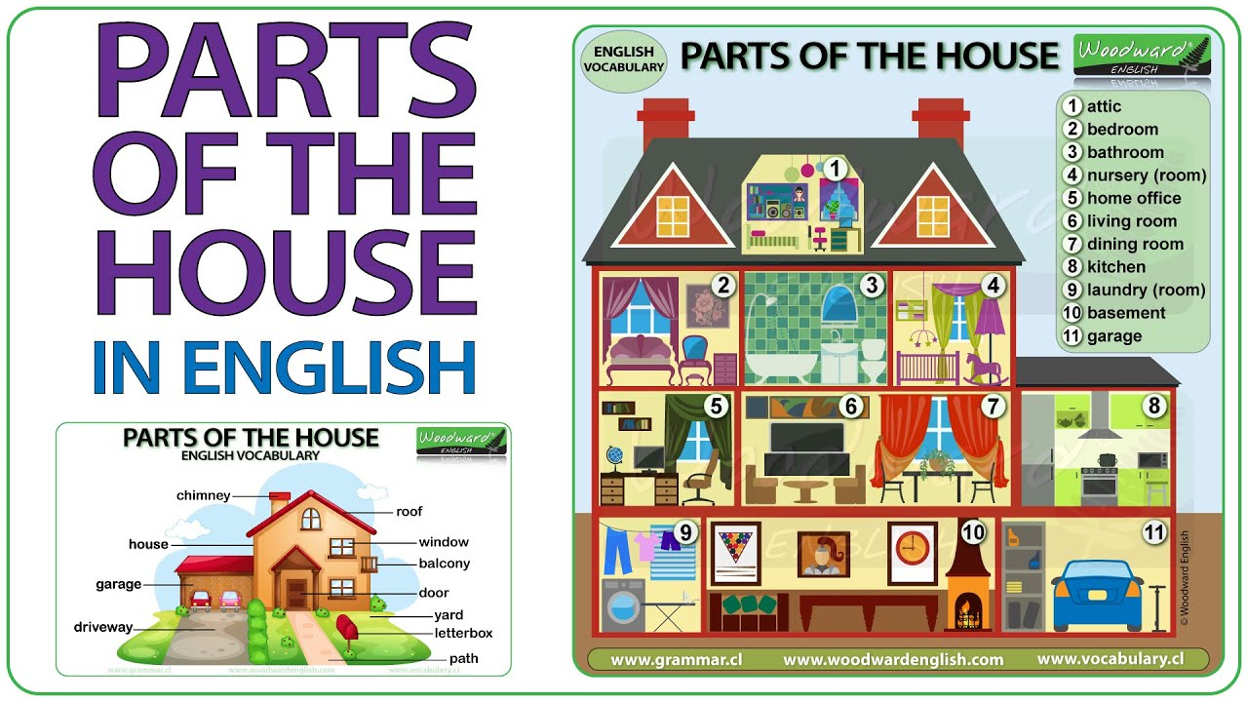
Let’s remember this:

Slide 6


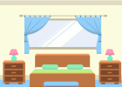

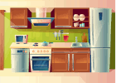

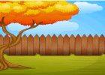

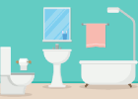






You can learn the house parts here with images easily. To listen to the pronunciation just tap on a picture.
house
🔊
living room
🔊
bedroom
🔊
kitchen
🔊
dining room
🔊
garden
🔊
backyard
🔊
door
🔊
window
🔊
balcony
🔊
attic
🔊
roof
house
🔊
living room
🔊
bedroom
🔊
kitchen
🔊
dining room
🔊
bathroom
🔊
garden
🔊
backyard
🔊
door
🔊
window
🔊
balcony
🔊
attic
🔊
roof
🔊
chimney
house
bedroom
living room
kitchen
door
backyard
garden
bathroom
dining room
window
balcony
attic
chimney
roof

Slide 7
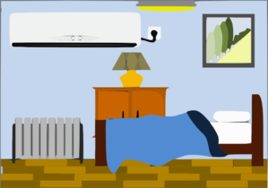


picture
bookcase
bed
lamp
bedside table
rug

Slide 8
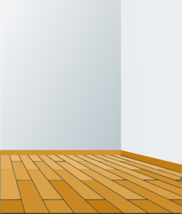


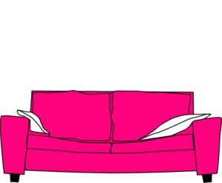


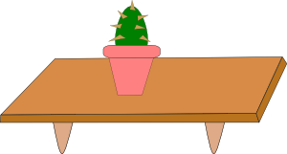
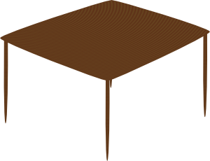

wall
curtains
shelves
sofa
armchair
TV
table

Slide 9

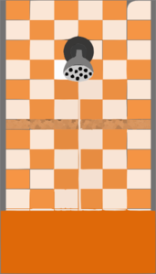
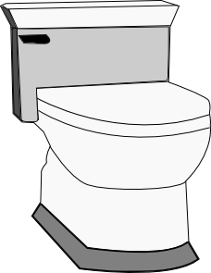
window
shower
toilet
washbasin

Slide 10
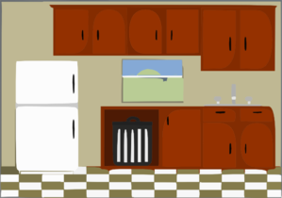
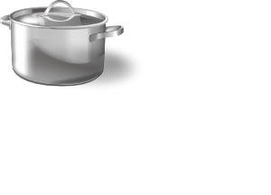

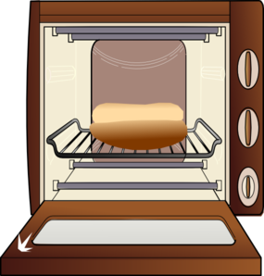
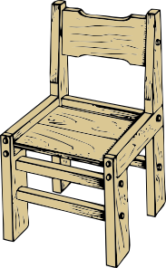

cupboards
fridge
sink
cooker
oven
chair
table

Slide 11
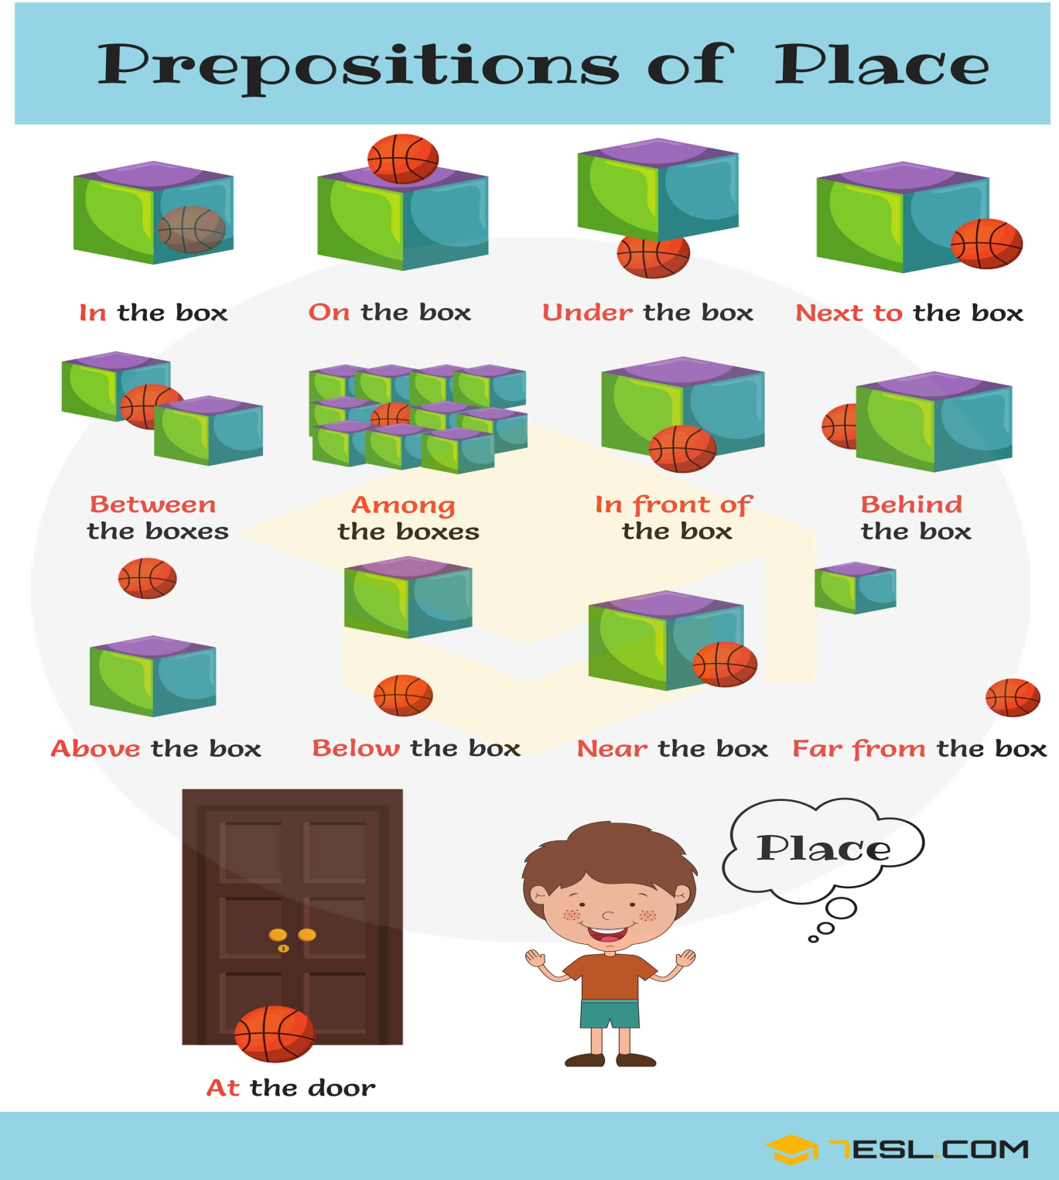

Slide 12

Let’s practice...
For each slide decide whether it is right or wrong. If it is wrong, you do a ‘thumbs down’ and if it is right a ‘thumbs up’. If it is a ‘thumbs down’ you can correct it, whereas if it is a ‘thumbs up’ you can read it.

Slide 13

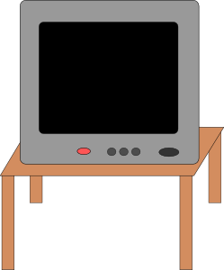

The TV is next to the door.

Slide 14
The sofa is on the rug.

Slide 15

The sofa is next to the TV.

Slide 16
The fridge is opposite the cupboards.

Slide 17
The fridge is near the cupboards.

Slide 18
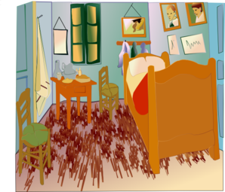
The bed is far from the bedside table.

Slide 19
The bed is near the bedside table.

Slide 20

The dog is under the desk.

Slide 21
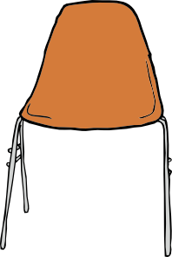
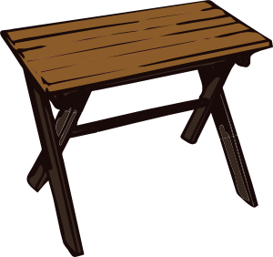
The swimming pool is between the table and the chair.

Slide 22
The swimming pool is near the table and the chair.

Slide 23
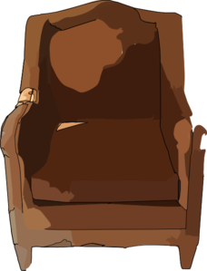
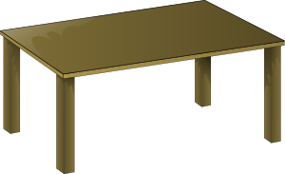
The chair is behind the table.

Slide 24


The shelves are near the computer.

Slide 25
The shelves are far from the computer.

Slide 26
The woman is in front of the washbasin.

Slide 27
The boy is in the bath.

Slide 28

Let’s practice more...

Slide 29
The books are on the ……… .
shelves

Slide 30
The cat is ………. the bedside table.
next to

Slide 31
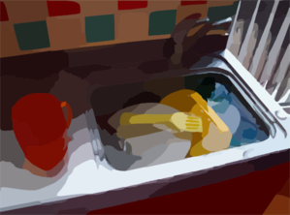
The dishes are in the ……….
sink

Slide 32

washbasin
The ………. is between the toilet and the ……….. .
shower

Slide 33
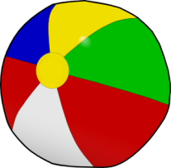
The ball is ……. the sofa.
under

Slide 34

The TV is ……. the chair.
opposite

Slide 35
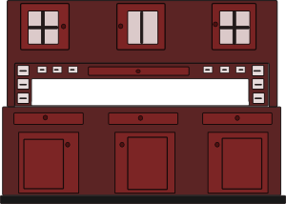
The table is ……. the cupboards.
in front of

Slide 36
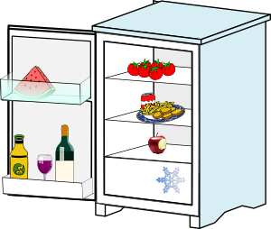
The cooker is ……. the fridge.
next to

Slide 37

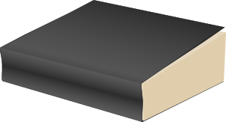
The book is under the …...
rug

Slide 38
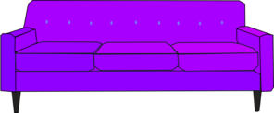
The sofa is ……. the table.
near

Slide 39

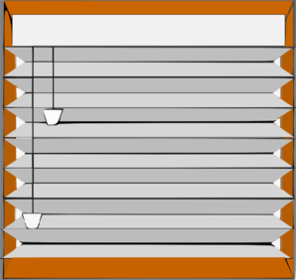
The window is ……………. the door.
far from

Slide 40
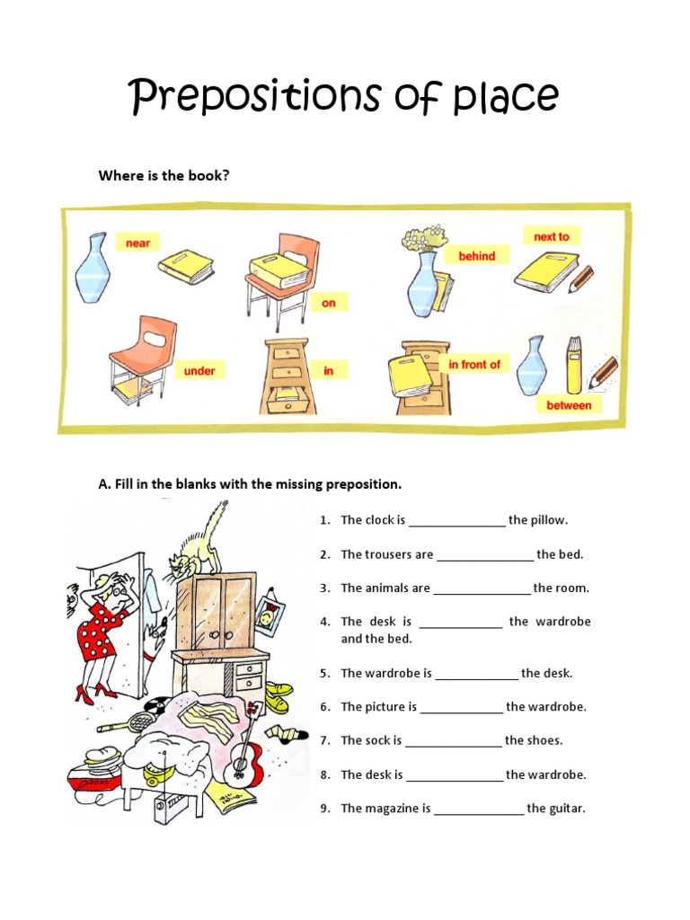
Write the correct answer in your notebook«ΤΟ ΣΧΟΛΕΙΟ ΜΑΣ ΕΙΝΑΙ ΕΔΩ»

Slide 41
Click on the link below to play a game! Don't forget when you finish to click on ‘finish’ for feedback!
https://learnenglishkids.britishcouncil.org/word-games/rooms

Slide 42
My house
I’ve got a small house. It’s got 3 bedrooms, one living room, a dining room, two bathrooms and a kitchen. That’s 8 rooms! . I love my room. It’s great. I like my home very much. It’s next to a park and I can play football on Saturdays and Sundays when the weather is nice. I love my room. It’s great.
Write about your house in your note book «ΤΟ ΣΧΟΛΕΙΟ ΜΑΣ ΕΙΝΑΙ ΕΔΩ»

Slide 43


