Slide 1


Εβδομάδα 9^{η} 18 /5/20 – 22/5/20
Hello everyone!
I hope you are all well and in good health!
Here you can see what you can do in English now…
I miss you all!
Sending you my love and best wishes!
Maria Christou

Slide 2

Present Simple
3rd person singular
Year 4

Slide 3
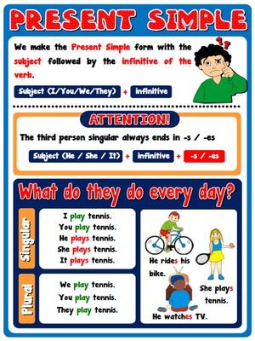
Let’s learn these:

Slide 4
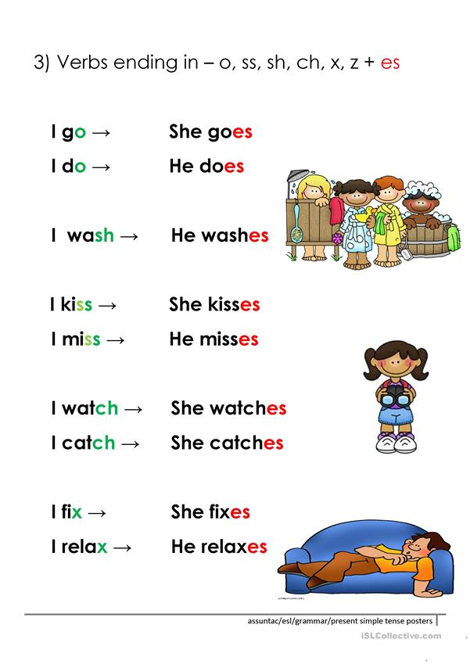
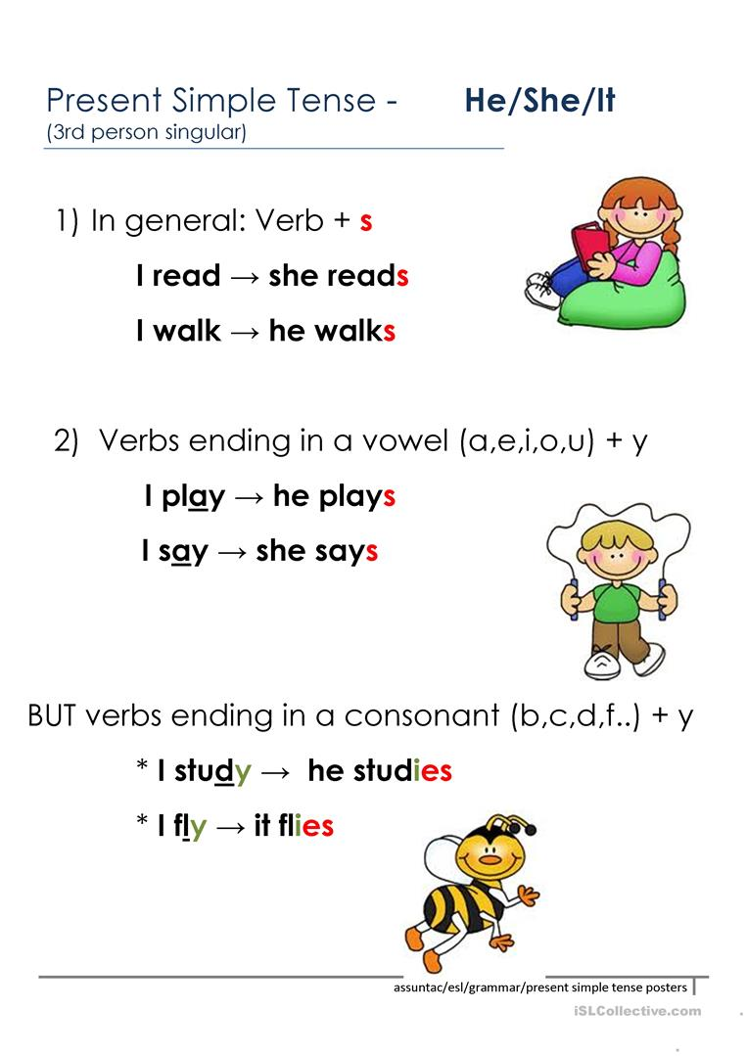

Slide 5
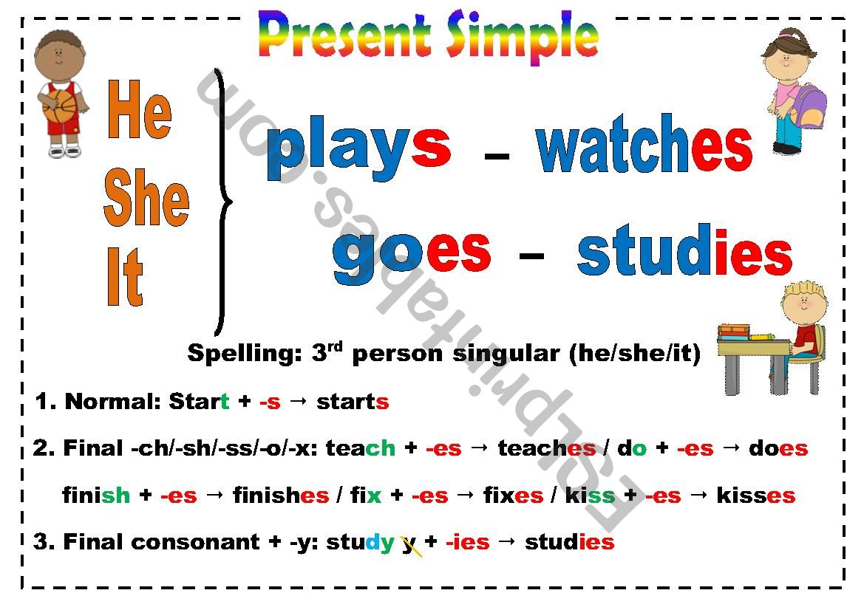

Slide 6
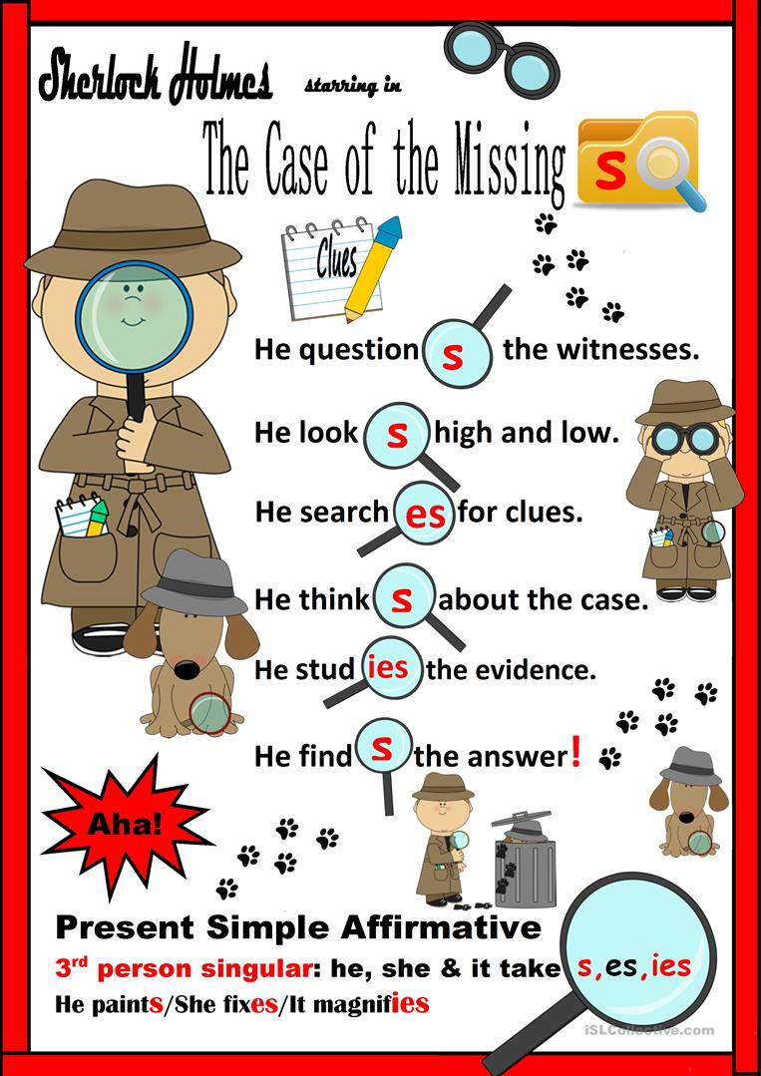

Slide 7
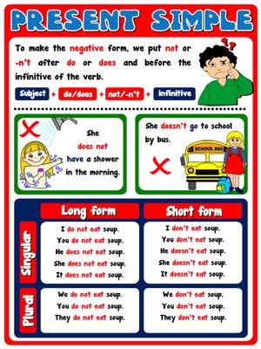

Slide 8
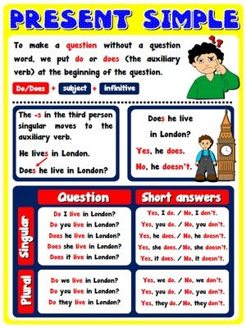

Slide 9
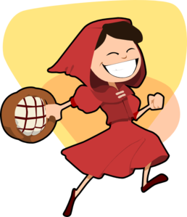
You can now watch a presentation about popular story characters and what they do every day:

Slide 10
Cinderella

Slide 11
She cleans the palace.

Slide 13
She plays with the big bad wolf.

Slide 14
Snow White

Slide 15
She watches TV.

Slide 16
Pinocchio

Slide 17
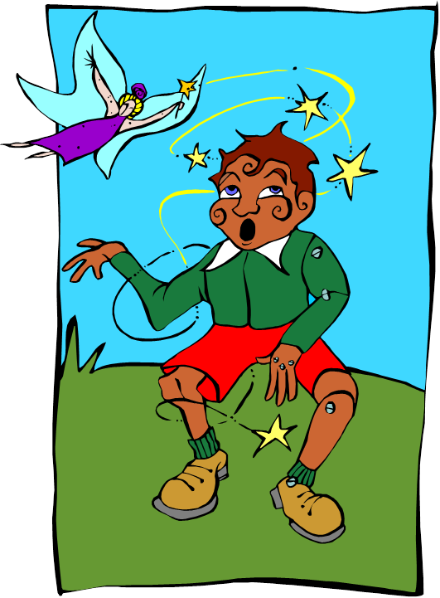
He plays football.

Slide 18
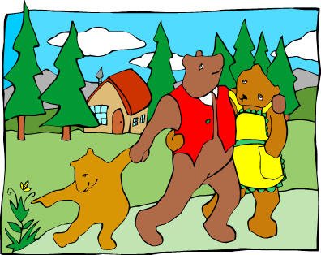
The three bears

Slide 19
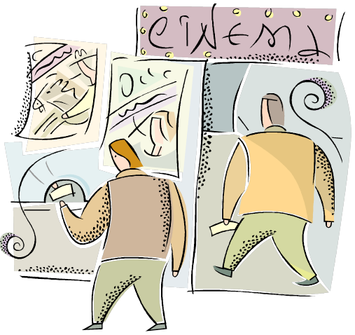

They go to the cinema.

Slide 20
Click on the links below to play the games.
https://learnenglishkids.britishcouncil.org/word-games/actions-1
https://learnenglishkids.britishcouncil.org/word-games/daily-routines
https://learnenglishkids.britishcouncil.org/word-games/actions-2
https://learnenglishkids.britishcouncil.org/word-games/actions-3

Slide 21

Listen to the tongue twister and practise saying it. How fast can you say it?
https://learnenglishkids.britishcouncil.org/tongue-twisters/i-scream-you-scream

Slide 22
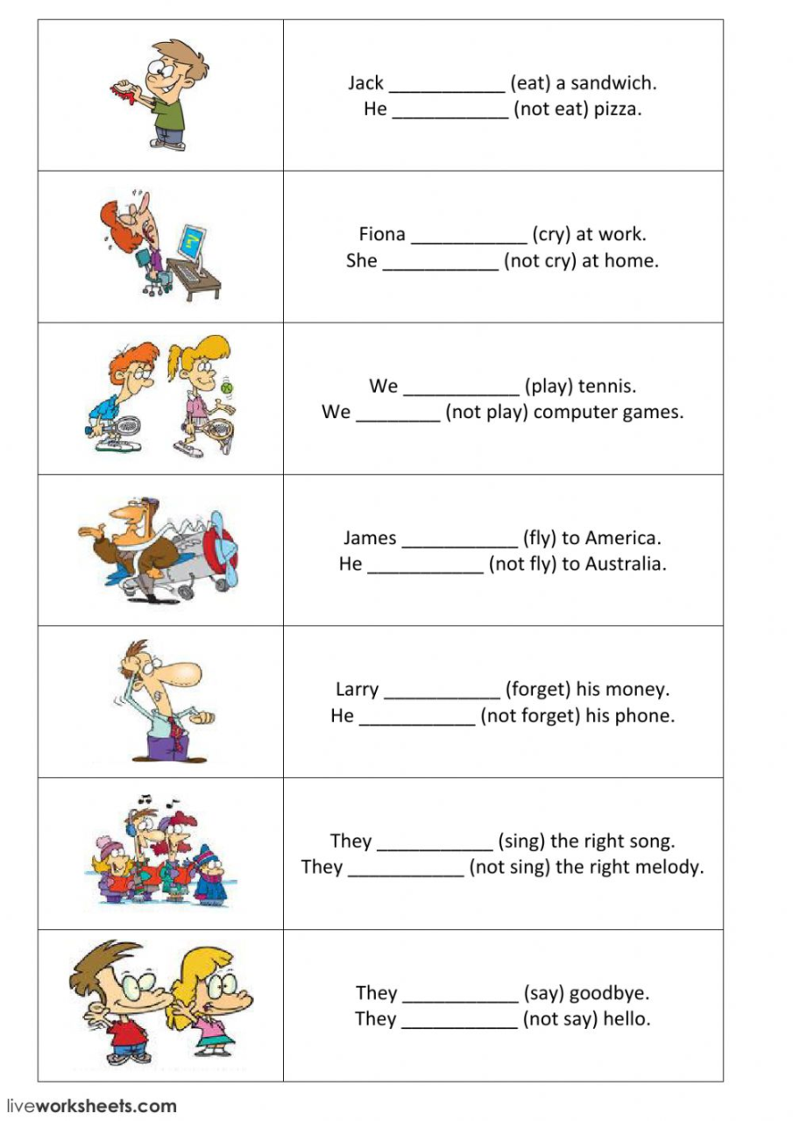
Write the answers in your notebook « Το σχολειό είναι εδώ »

Slide 23

If you have your activity book do unit 14 pages 47-48.

Slide 24
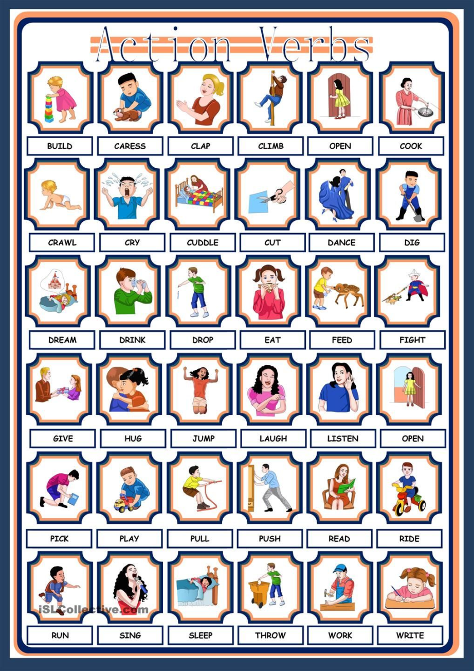
Update your entry or make a new entry on action verbs in your picture dictionary or the notebook « Το σχολειό είναι εδώ »
You can choose some of the verbs from this poster.

Slide 25


