Slide 1
ENGLISH- 4th Grade 4-8/5/2020
Hello everyone!
I hope you are all well and in good health!
Here you can see what you can do in English now…
I miss you all!
Sending you my love and best wishes!
Maria Christou

Slide 2
Let’s talk about likes and dislikes (ask and answer)
Year 4

Slide 3
Let’s remember this...
Does he/she like…? Yes, he/she does. No, he/she doesn’t.
Do they like ….? Yes, they do. No, they don’t.
Do you like…? Yes, I do/No, I don’t.
I like…, I don’t like…
He / She likes … / He / She doesn’t like…

Slide 4
...this:

Slide 5
And this:

Slide 6
Let’s practice...

Slide 7
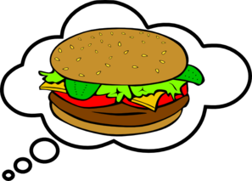
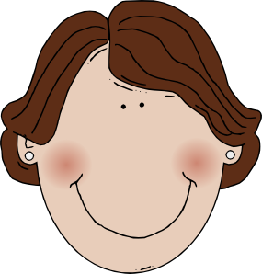
She hamburgers.
likes

Slide 8
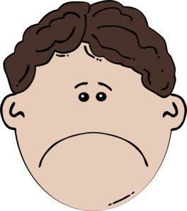
He lemonade.
doesn’t like

Slide 9
She chicken.
likes

Slide 10
like
They apples.

Slide 11
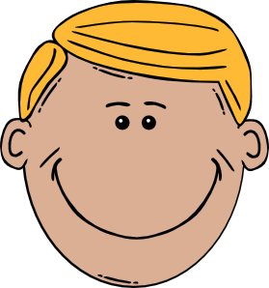
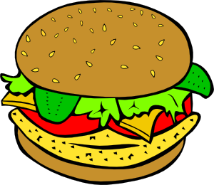
Does he hamburger and chips?
Yes, he does.
like

Slide 12
Does
he like chicken?
No, he doesn’t.

Slide 13
Does she like sausages?
No, she .
doesn’t

Slide 14
they like chips?
No, they don’t.
Do

Slide 15
Let’s practice more...
Notes:
#

Slide 16
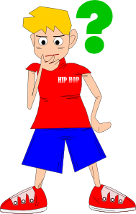
Does he like football?

Slide 17
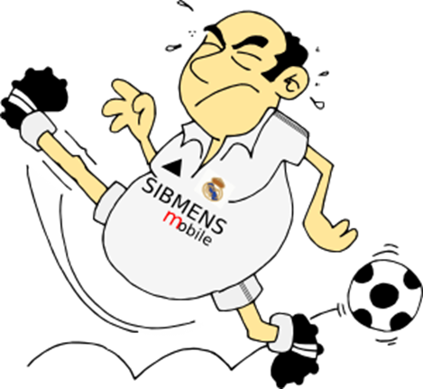
No, he doesn’t.
He doesn’t like football.

Slide 18
Does she like basketball?

Slide 19
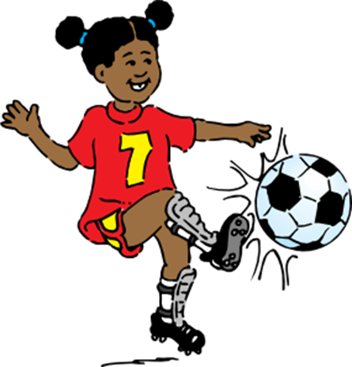
No, she doesn’t.
She likes football.

Slide 20
Does she like tennis?

Slide 21
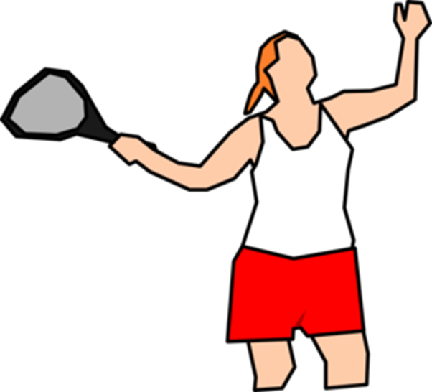
Yes, she does.
She likes tennis

Slide 22
Do they like volleyball?

Slide 23
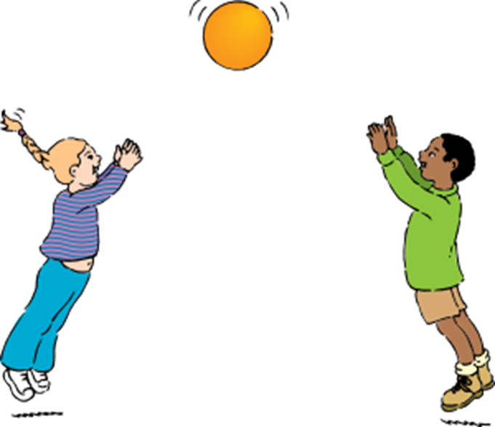
Yes, they do.
They like volleyball.

Slide 24
Does he like tennis?

Slide 25
Does he like tennis?

Slide 26
Let’s play! click on the link below to play the two games.
https://learnenglishkids.britishcouncil.org/grammar-practice/and-dont#

Slide 27
Answer the questions in your notebook: « To σχολειό είναι εδώ »
How many children are there?
Who are they?
What animal can you see in the picture?
Is the puppy naughty?
Does the puppy like fish?
What does the puppy like?

Slide 28
Write the answers in your notebook « το σχολειο ειναι εδω »

