Slide 1

Feelings
ΑΓΓΛΙΚΑ – ΤΑΞΗ Γ΄
English Language – Year 3
Θέμα: Feelings

Slide 2
Let’s remember this story!!!
(CLIck on the link)
https://safeYouTube.net/w/sWxF

Slide 3
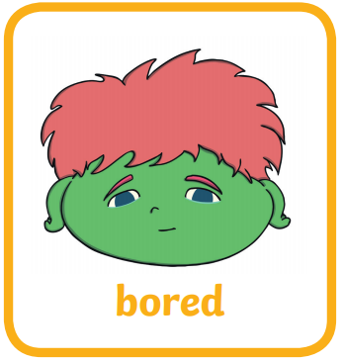

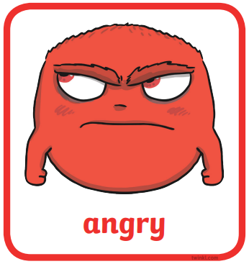


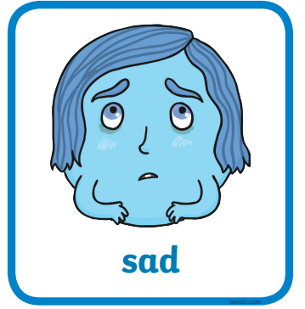
Feelings
Listen, point and say:

Slide 4
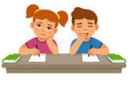
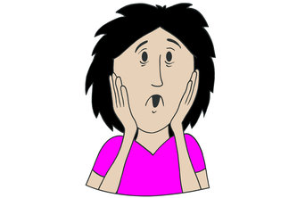
Feelings
Read and say:
bored
scared

Slide 5
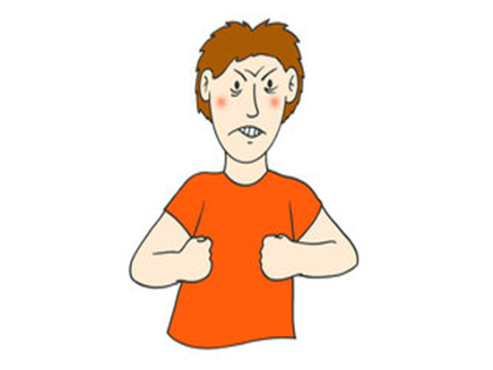
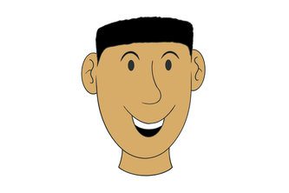
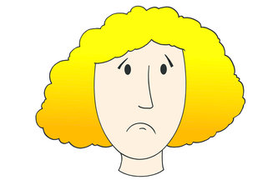
Feelings
Read and say:
happy
angry
sad

Slide 6
Read and copy in your notebook «ΤΟ ΣΧΟΛΕΙΟ ΜΑΣ ΕΙΝΑΙ ΕΔΩ»:
TO BE
I am
You are
He is
She is
It is

Slide 7

Let’s read:
I am angry
You are angry. I am scared.

Slide 8
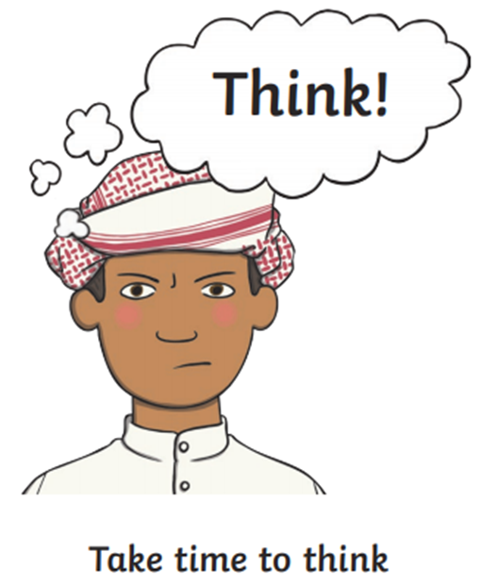
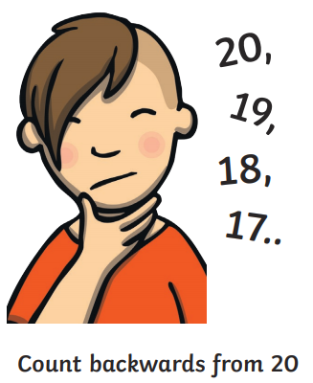
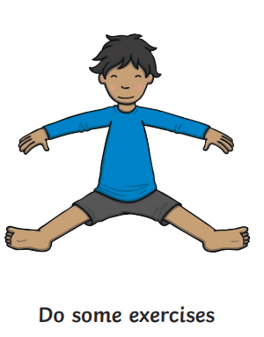
Feelings: Things to do when you are angry. Let’s read!

Slide 9

Match the words with the pictures and write them in your notebook «ΤΟ ΣΧΟΛΕΙΟ ΜΑΣ ΕΙΝΑΙ ΕΔΩ»:
Bored 4. Happy
Scared 5. Angry
Sad
A
C
B
E
D

Slide 10
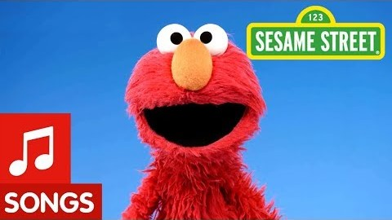
Sing along!!!
(click on the picture)

Slide 11
Copy the sentences in your notebook, complete them and read:
say "I am”, and you know it, hug a friend,
you're scared and you know it, stamp your feet
If you're happy __________________________ play the drum.
If you're sad and you know it ___________________________
If ________________________________ , sing a song.
If you’re bored and you know it, ________________________
If you're angry and you know it, ________________________________

Slide 12


