Slide 1

Bear HUNT
ΑΓΓΛΙΚΑ – ΤΑΞΗ B΄
English Language – Year 2
Θέμα: Bear Hunt – Digraph SH

Slide 2
Listen to the story “We are going on a bear hunt” as it is narrated by the author of the book!!!
(click on the link)
https://safeYouTube.net/w/dYxF

Slide 3
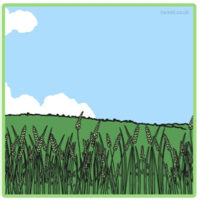
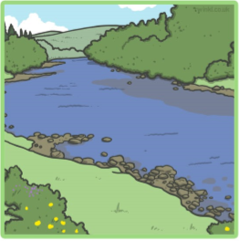
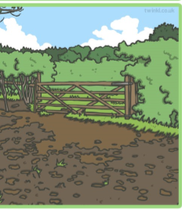
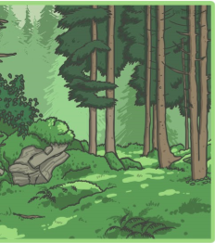
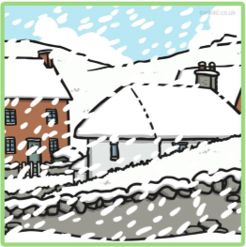
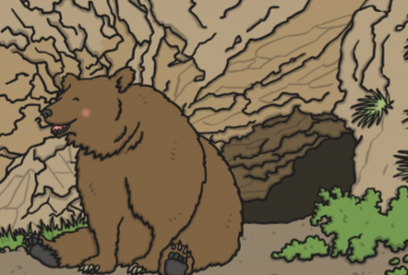
WE ARE GOING ON A BEAR HUNT
Point, read and say:
grass
river
mud
forest
snowstorm
cave

Slide 4
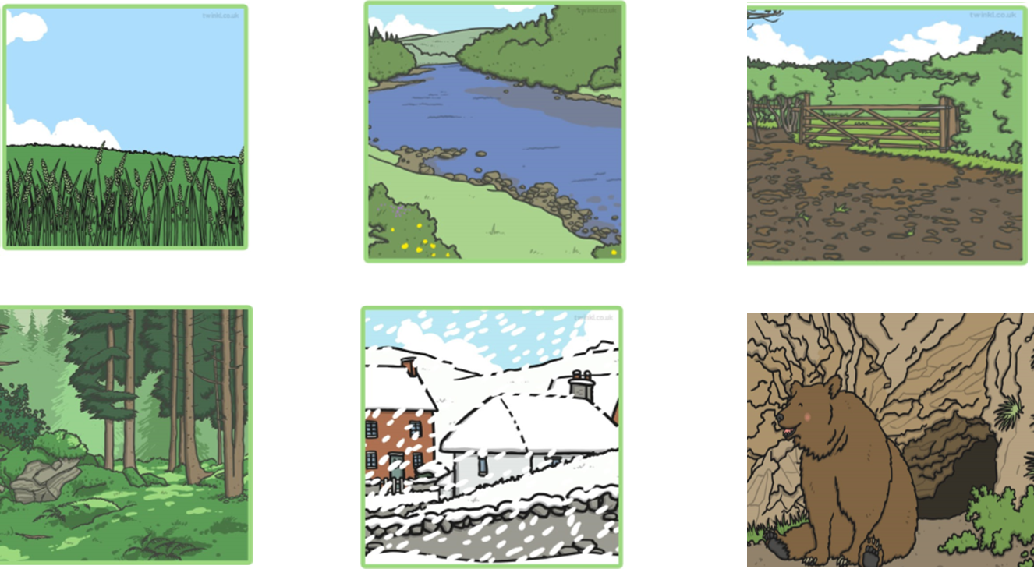
WE ARE GOING ON A BEAR HUNT
Write the words in your notebook «ΤΟ ΣΧΟΛΕΙΟ ΜΑΣ ΕΙΝΑΙ ΕΔΩ»

Slide 5
WE ARE GOING ON A BEAR HUNT
Digraphs:
Listen to the digraph song!
(click on the link)
https://safeYouTube.net/w/zZxF

Slide 6
What’s this sound?
(click on the link)
Sh
https://safeYouTube.net/w/cayF

Slide 7

How many sh sounds can you spot?

Slide 8


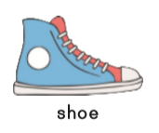


Write the words that have sh in them in your notebook «ΤΟ ΣΧΟΛΕΙΟ ΜΑΣ ΕΙΝΑΙ ΕΔΩ»:
fish

Slide 9
Let’s practice a little bit more:
(click on the link)
https://safeYouTube.net/w/uayF

Slide 10
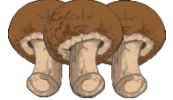








Match the words with the pictures and copy them in your notebook «ΤΟ ΣΧΟΛΕΙΟ ΜΑΣ ΕΙΝΑΙ ΕΔΩ»
Cash, fish, polish, shampoo, fish, mushrooms, shark, splash

Slide 11


