Slide 1

Feelings
ΑΓΓΛΙΚΑ – ΤΑΞΗ A΄
English Language – Year 1
Θέμα: Feelings

Slide 2





Feelings
Listen, point and say:

Slide 3

Feelings
What’s missing?

Slide 4
Feelings
What’s missing?

Slide 5
Feelings
What’s missing?

Slide 6
Feelings
What’s missing?

Slide 7
Feelings
What’s missing?

Slide 8
Feelings
What’s missing?

Slide 9
Feelings
What’s missing?

Slide 10
Feelings
What’s missing?

Slide 11
Feelings
What’s missing?

Slide 12
Feelings
What’s missing?

Slide 13
Feelings
What’s missing?

Slide 14
Feelings
What’s missing?

Slide 15

Feelings
What’s missing?

Slide 16

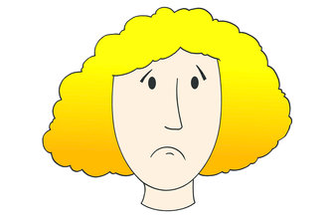
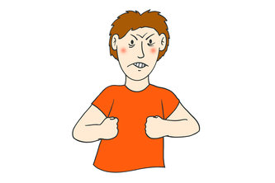

Let’s play
“Simon says”

Slide 17
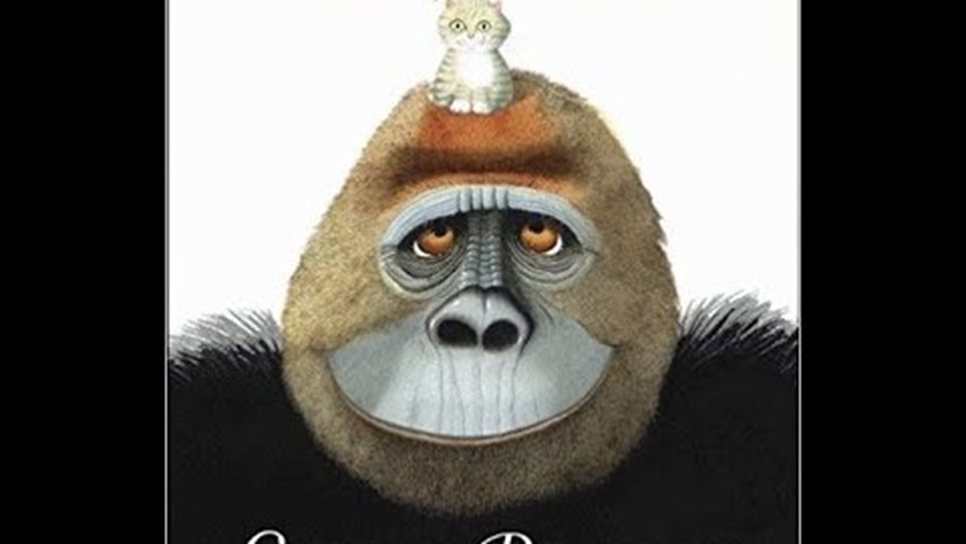
STORYTIME!!!
(Click on the Picture below)
https://safeYouTube.net/w/ABxF

Slide 18
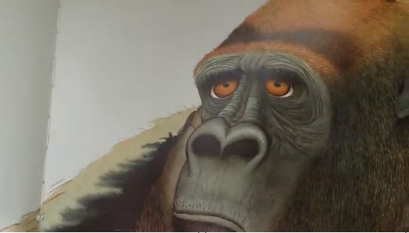
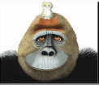
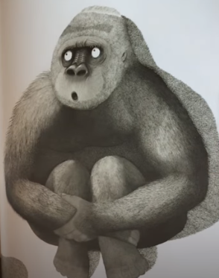
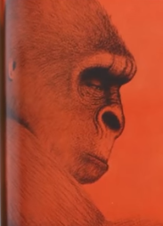
Feelings: How does the gorilla feel?

Slide 19
Feelings: Let’s play a game!!!
Click on the link below.
Spin the wheel and say how the monster feels e.g. It’ s angry! It’ s a happy monster!
https://wordwall.net/resource/2092408

Slide 20

NoW SING ALONG!!!
(click on the picture)

Slide 21


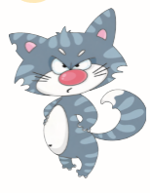

Feelings
In your notebook «ΤΟ ΣΧΟΛΕΙΟ ΜΑΣ ΕΙΝΑΙ ΕΔΩ» draw a sad animal, a happy animal, an angry animal and a scared animal. Remember to write the date and the title «Feelings».
Example
This is a small, happy fish!
This is a black cat. It’s scared!
This is a cat! It’s angry!
This is a dog! It’s sad!

Slide 22


