Slide 1
The use of tablets in improving learning outcomes
Enhancing mathematics teaching and learning
Dimotiko Scholeio Makedonitissas 3 – Stylianos Lenas
Thursday, 8 June 2017
Notes:
It is both educational and research program.
We are currently at the beginning of the research program, but as we go more into the program, we focus on the subject of maths.

Slide 2
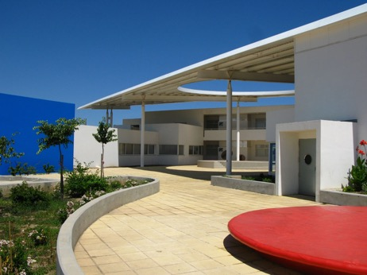
Dimotiko Scholeio Makedonitissas 3 – Stylianos Lenas
Year of establisment: 2009
Number of pupils: 420
Age of pupils: Year 1 (6 years old) – Year 6 (12 years old)
Number of classrooms: 18 (3 in each year – 25 pupils max)
Number of teaching stuff: 32
Technology infrastructure: All classrooms and labs are equipped with 3 pcs with access to high speed wired internet (content filtered) and a video projector. There is also a fully equipped computer lab. Finally the school runs a 1:1 tablet program with 30 tablets.

Slide 3
Contents
The integration of new technologies: The beginning… 2015-16
Stages followed for the tablets program…
designing and implementing the 2016-2017 program
The tablets educational program… strengths and limitations
The tablets research program - EUC

Slide 4














1. The integratiotion of new technologies: The beginning… 2015-16
The Innovative Schools Program…towards a digital culture
Notes:
I have been working in this school for the last two years.
Since I first went to this school, I had in mind a tablets program (urban school – high socioeconomic level).
I wanted to form a solid strong team for the coordination of the program… and this was easier than I thought.
But the rest of the stuff wasn’t ready…we had to create both a learning and digital culture towards the use of new technologies.
It was going to be a rather big learning curve for most of the stuff members, but we had to persuade them that through the use of new technologies they could transform their teaching and achieve more with their students.
Professional development – presentations during stuff meetings, seminars, hands on practice, guests speakers

Slide 5
Basic principles for the use of new technologies… a constructivist approach to lesson planning
Learning Activities | Teacher’s role | Pupil’s role | Use of technology | Added value | Classroom setting
Orientation
Elicitation of ideas
Seeking background Knowledge
Restructuring of ideas
Application of ideas
Review
Notes:
The professional development effort led to the pedagogical practice which was actually the design of lessons integrating the use of technology
At the designing stage of the lesson I decide:
If I need to use any new technologies
What is the added value?
Which lesson objectives do I want to meet?
When and for how long will I use it?
What is the teacher’s and the pupils’ role?

Slide 6
2. Stages followed for the tablets program… designing and implementing the 2016-2017 program
1
School profile and needs analysis
2
Teacher Training- Erasmus+ KA01
3
The need for scientific associates – PI, EUC, Erasmus+
4
Action Plan design (educational part + research part)
6
Promotion - Implementation
5
Teachers’ Professional Learning - PI
Notes:
3. We identified the need of having people tha could:
Guide us
Train us
Help us design an action plan and set goals
Basically bring their theory into our practice and vice versa

Slide 7
School implementation model (stage 1)
School Policies
Teaching Quality
External
Scientific Associates
Evaluation
Reflection
Learning Outcomes

Slide 8
School Professional Learning (stage 2)
Teachers’ Professional Learning
SCHOOL
PEDAGOGICAL INSTITUTE
TEACHERS
PARENTS
DEPARTMENT OF EDUCATION EUC
STUDENTS
Notes:
According to the Ministerial decision on 19/8/2015:
The focus of professional learning is transferred to the school.
Each school prepares its Professional Learning Action Plan
Individual Professional Learning
School-Based Professional Learning
The Cyprus Pedagogical Institute is the official body responsible for teachers’ professional learning and development.

Slide 9
The use of tablets – some key decisions
Added value purpose use
Meet specific attainment targets – holistic interdisciplinary approach
Emphasis on the gestures – content tranformation
Not full lesson use – Learning activity focused use
Tablet reservation system – Get them all involved
Android not iPads
The use of technologies as a means of teaching and learning
>50 000 apps. / ease of use/ formative assessment. / creativity/ motive

Slide 10
3. The tablets educational program… strengths and limitations our example in pictures

Slide 11
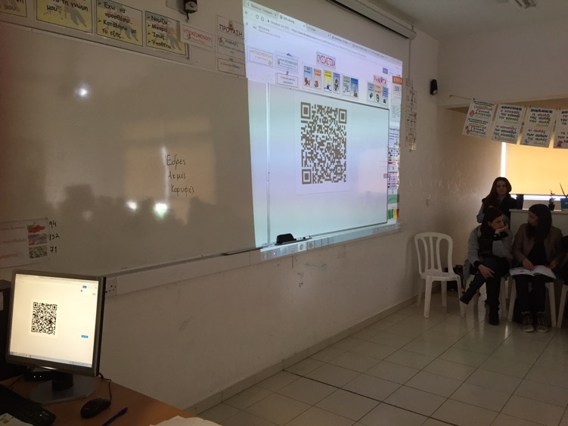
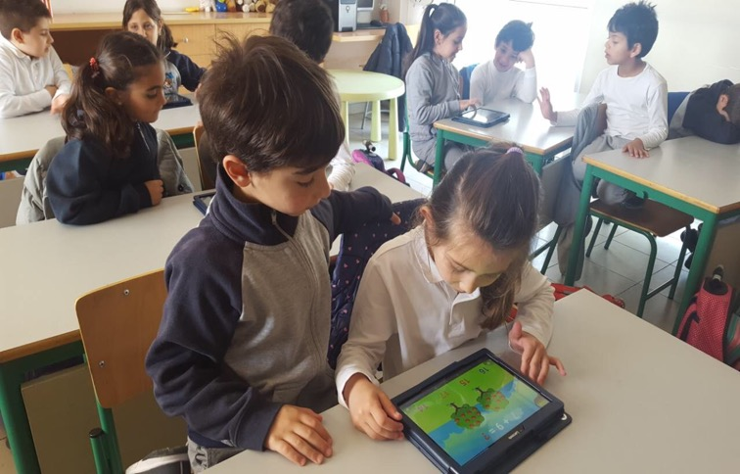
Ease of access to urls
Understanding of abstract concepts
Notes:
Go beyond the apps
Understang anything that goes beyond our senses – like the water cycle

Slide 12
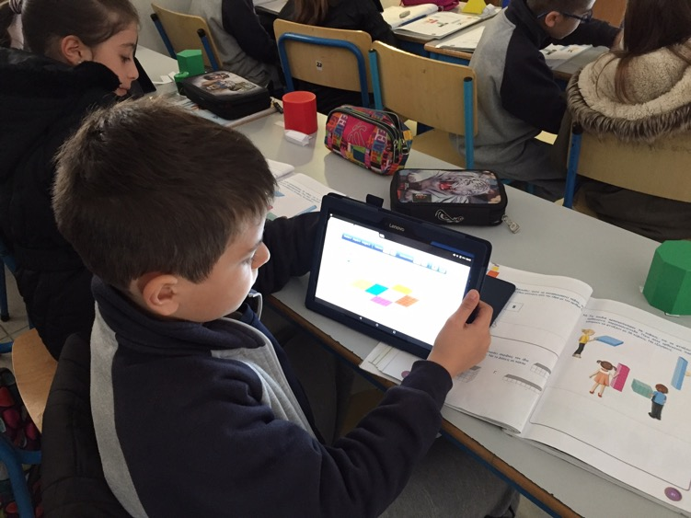
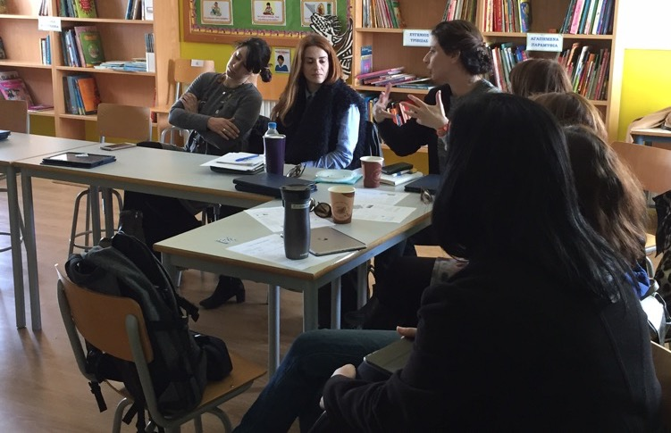
Working alongside textbooks – more interactivity opportunities
Reflection

Slide 13
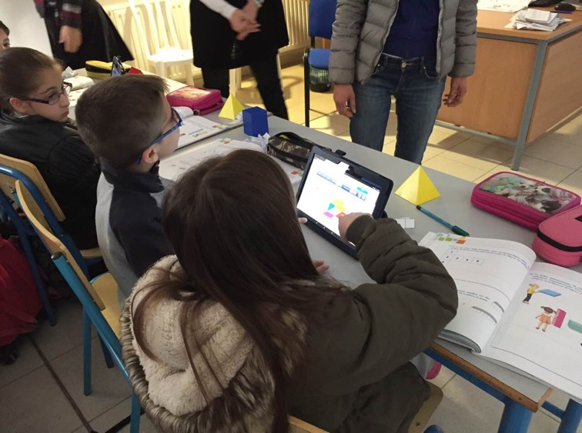
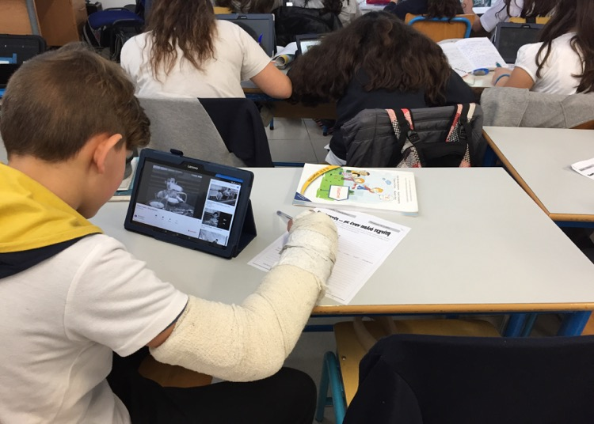
Content transformation
Increasing the range and sophistication of possible activities
Notes:
Content transformation
geometric solids – cube spread/net – count the faces / edges / vertices
A square to a rectangle
An equilateral to an isosceles
Practicing direct and indirect speech by watching a charlie chaplin silent film

Slide 14
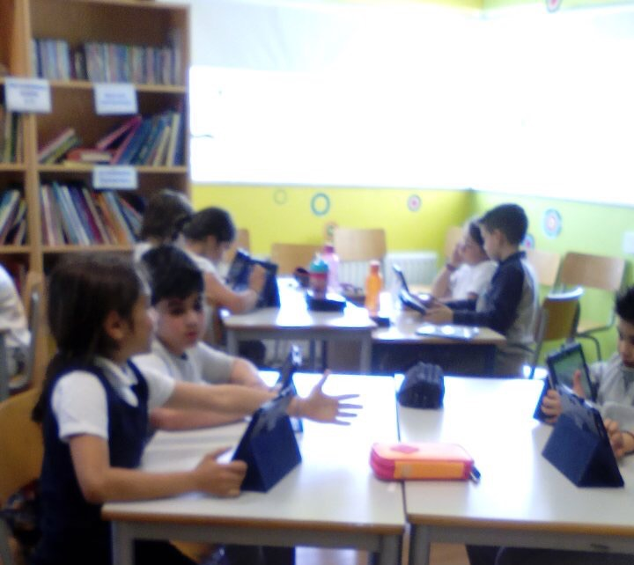
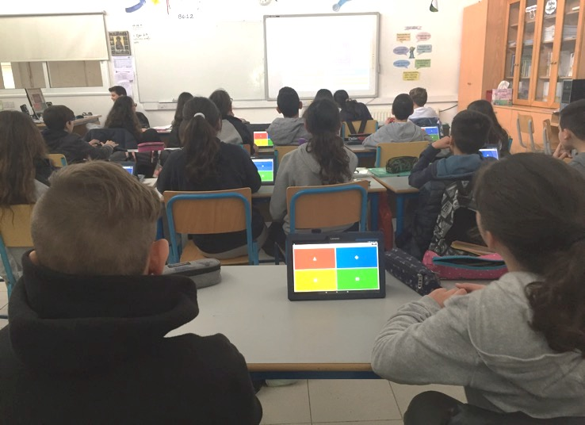
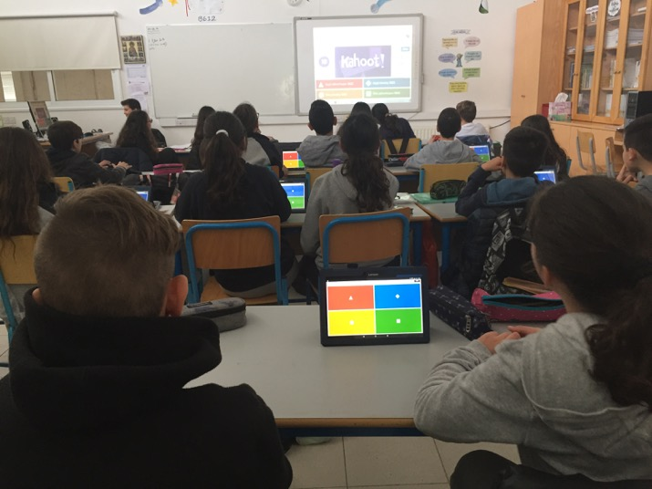
The use of technology shifts to the hands of the pupils
New ways of formative assessment

Slide 15
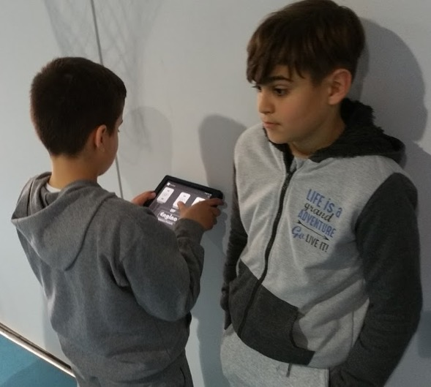
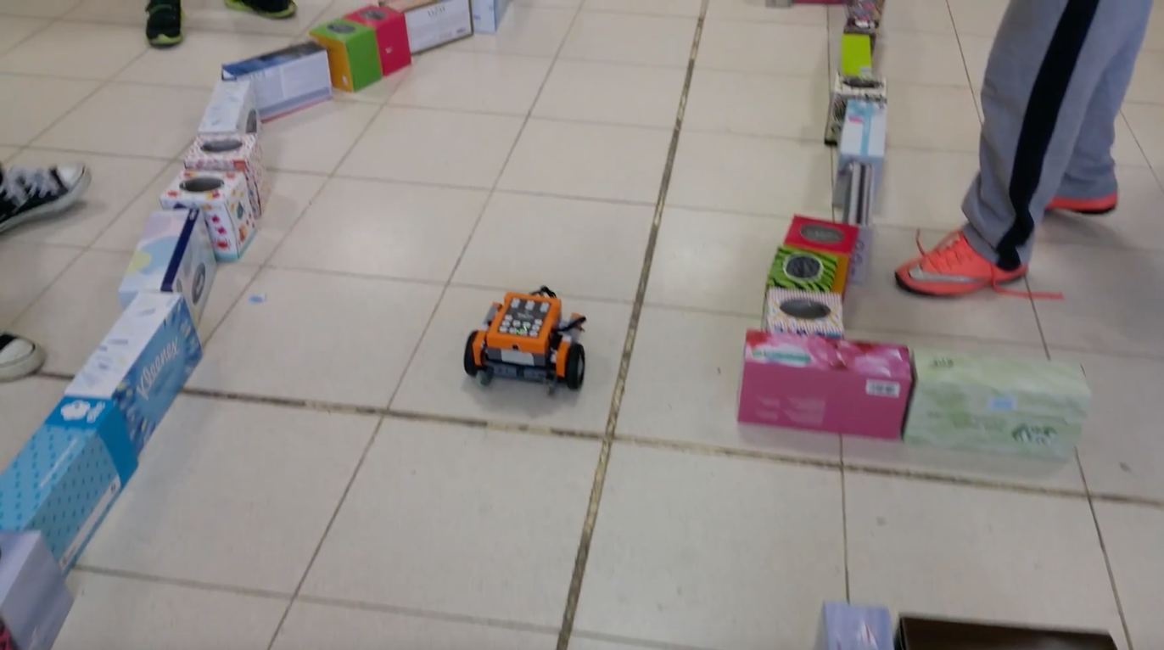
Advancement of higher cognitive functions and 21st century skills
Rich and dynamic environment
Notes:
Complex communication – new media literacy – self directed learning

Slide 16
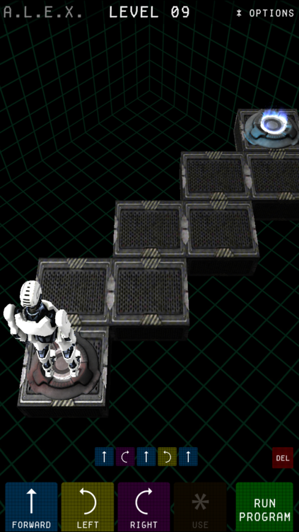
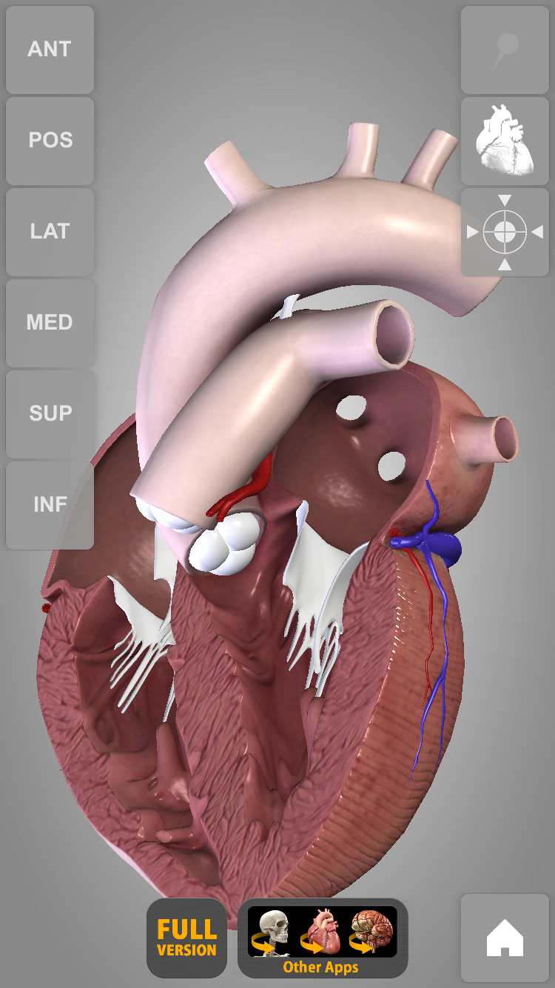
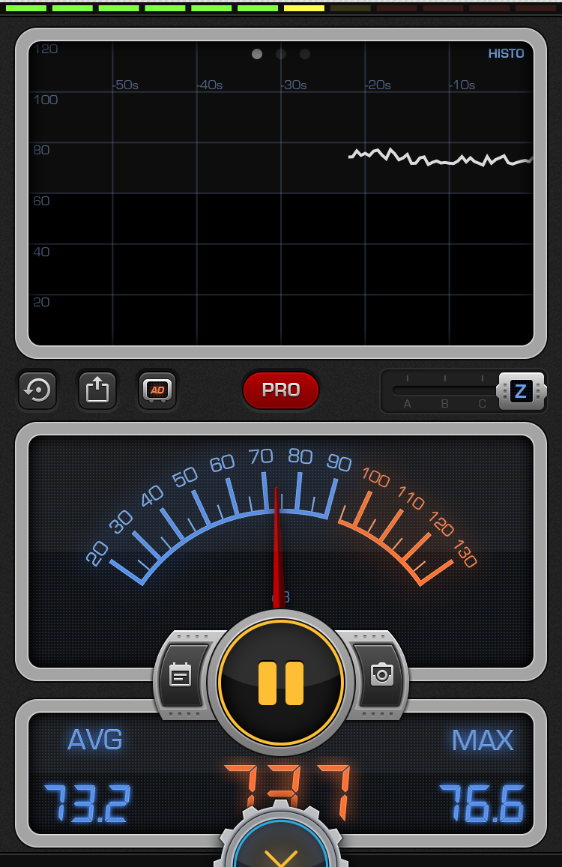
Delivering content that would be difficult to do so without the use of new technologies

Slide 17
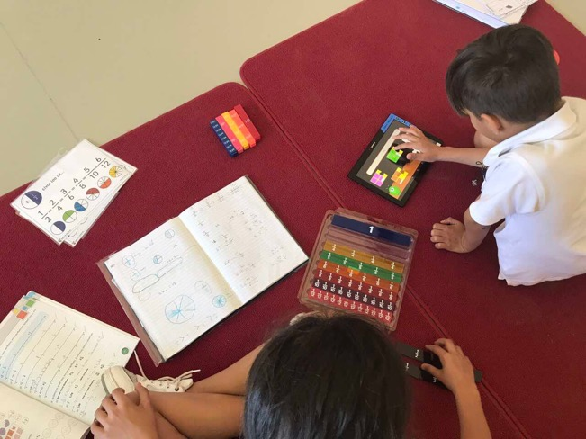
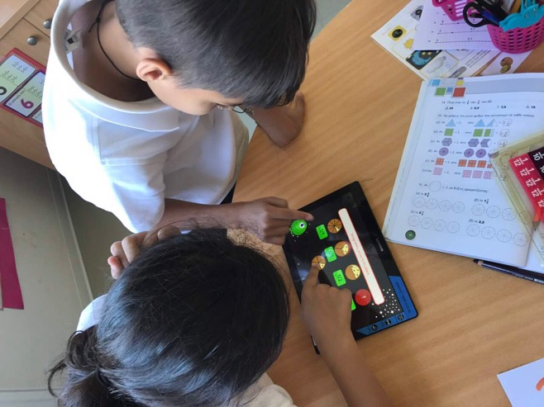
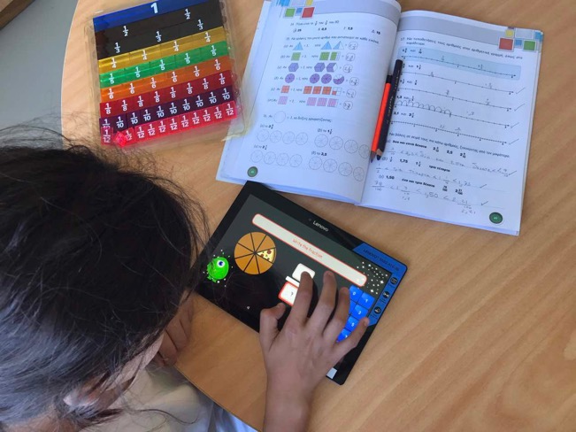
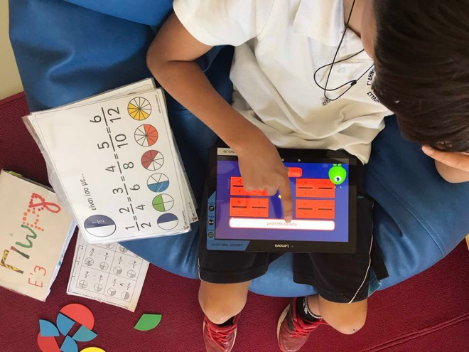
Promoting a more pupil centered, inclusive and engaging curriculum
Accelerated learning
Automatic stuctured feedback
Motivating and active learning environment (Quillan 2011)
Device portability (Burden et al. 2012)

Slide 18
… limitations / challenges
Resistance to change – teacher participation
Safety, storage, charging, carring, wi-fi access, screen monitoring etc.
Teacher development – training
The necessity for scientific partners

Slide 19
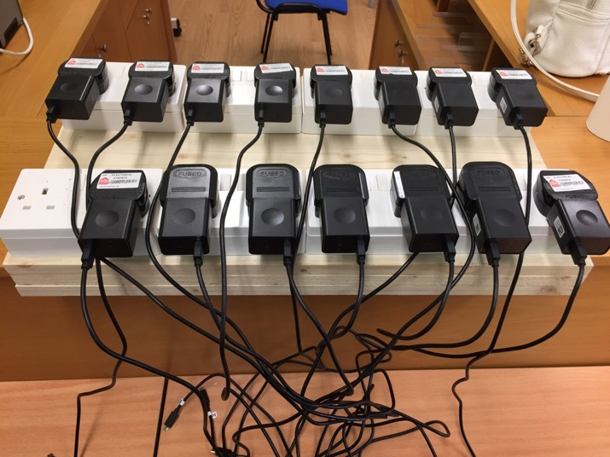
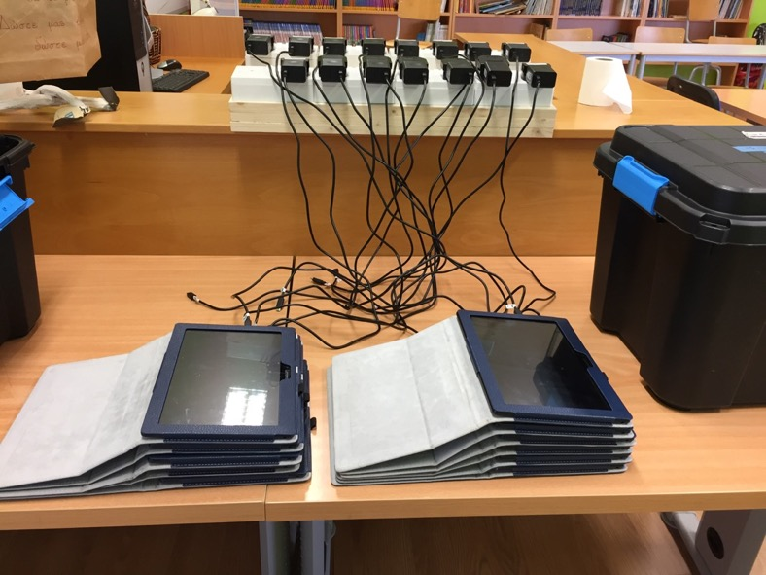
Charging
Purchase cost / no BYOD

Slide 20
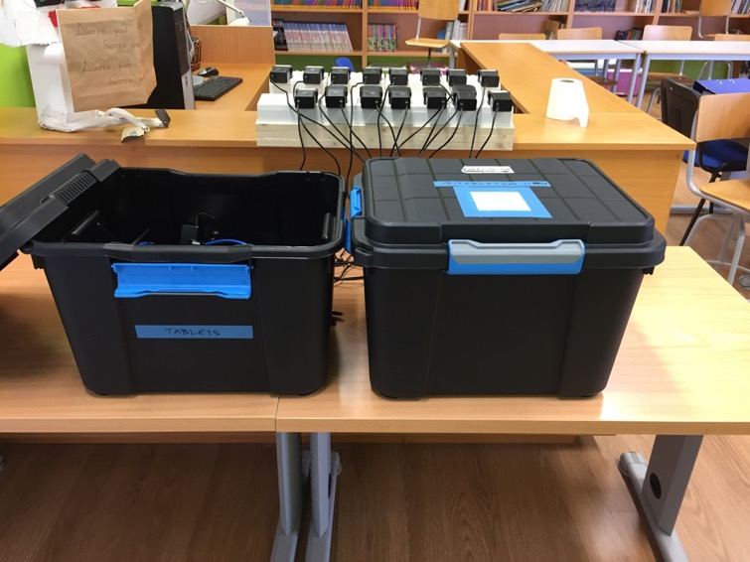
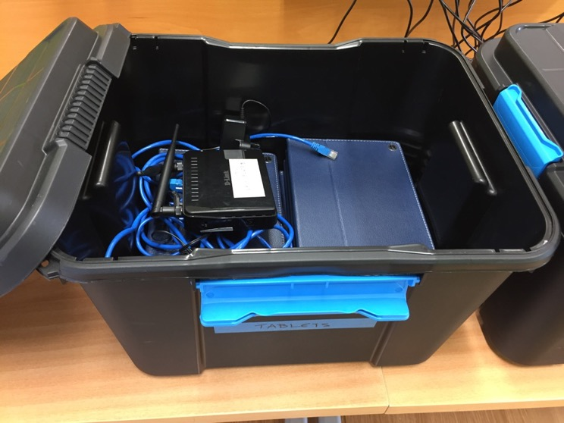
Currying
Wi fi access

Slide 21
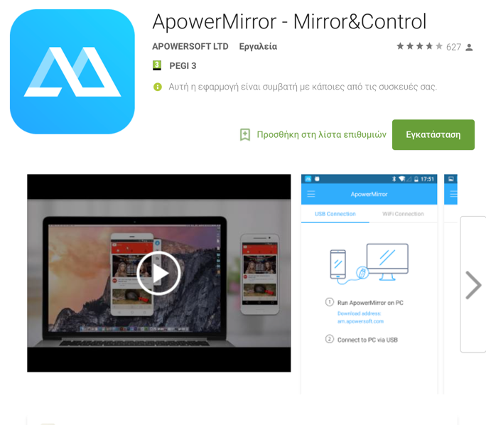
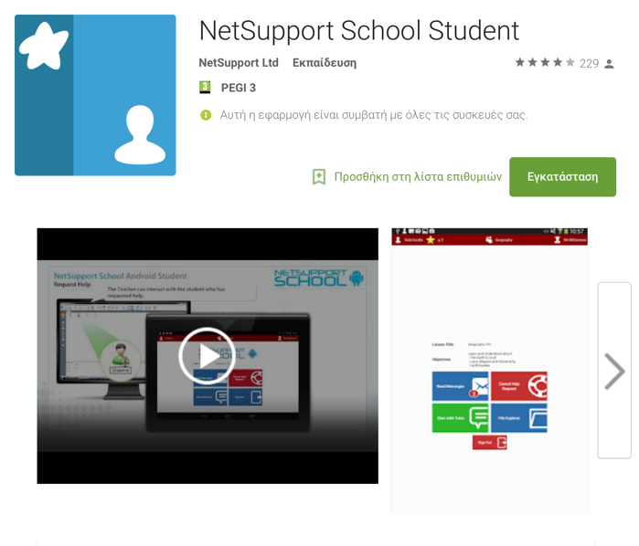
Mirroring and monitoring screens

Slide 22
Full eploitation / use consistency / program viability

Slide 23
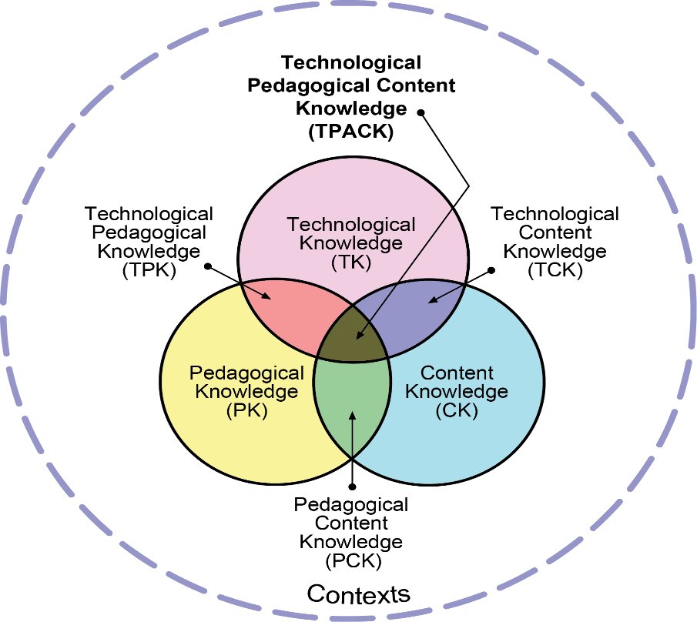
4. The tablets research program - EUC
Notes:
Technological Pedagogical Content Knowledge (TPACK) attempts to identify the nature of knowledge required by teachers for technology integration in their teaching, while addressing the complex, multifaceted and situated nature of teacher knowledge.

Slide 24
Phase 1: Pre-implementation (August 2016 – December 2016)
-Setting of implementation plan
-Teacher training workshop (6-7/9/2016)
Phase 2: Pilot implemantation (January 2017- May 2017)
-algebra and statistics tests
-questionnaires about the use of tablets
- Data collection (audio and video recordings, online questionnaires, tests etc)
- Selection of tablet apps (+PCs)

Slide 25
Phase 3: Evaluation of the pilot implementation (June – August 2017)
-Data Analysis
-Redesigning and finalizing the selection of tablet apps
Phase 4: Full implementation (September 2017 – June 2018)
-Full use of tablets on 1:1 basis
-From Maths to STE(Α)M (Science, Technology, Engineering, (Arts), Mathematics).

Slide 26
Phase 5: Implementation of educational program (Sep. June 2019)
After analyzing and evaluating the research data an action plan will be designed for the full implementation of a clean educational program.

Slide 27
Thank you!
Demetris Nicolaou demetris.nic@gmail.com

